Slide 1

Technology and Writing Centers:
How can research, training, and open-mindedness increase accessibility ?
By Reagan Flynn

Slide 2
“Beyond the Lore: A Case for Asynchronous Online Tutoring Research” - by Kathryn Denton
Idealists
Pragmatists
“the writing center is characterized by engaged, willing, and enthusiastic students who gain insights into their writing through tutor-guided dialogue” (Denton 180)
Idealists see tutors as observers who step back and let the student direct their own learning experience
“Tutoring… is tailored to the student seeking assistance, and the tutor is responsive to the student’s needs.” (Denton 180-181)
Pragmatists are generally proponents of flexibility in tutoring format, so as to be able to most effectively meet the needs of all students

Slide 3
So what about asynchronous online tutoring?
Idealists
Pragmatists
Since idealists see the writing center as a space for dialogue and the equal exchange of ideas between tutor and student, many idealists are wary of asynchronous online tutoring.
Critics are concerned that asynchronous tutoring is not conducive to student-directed learning
In general, pragmatists are more open to the idea of asynchronous online tutoring, since this option extends writing center accessibility to a wider population of students.
However, since there is limited pedagogical research on this platform, pragmatists often rely upon their personal and professional experiences and opinions when taking a stance on the validity of this tutoring style.

Slide 4





Activity!!
If you volunteer, you win brownie points ☺

Slide 5
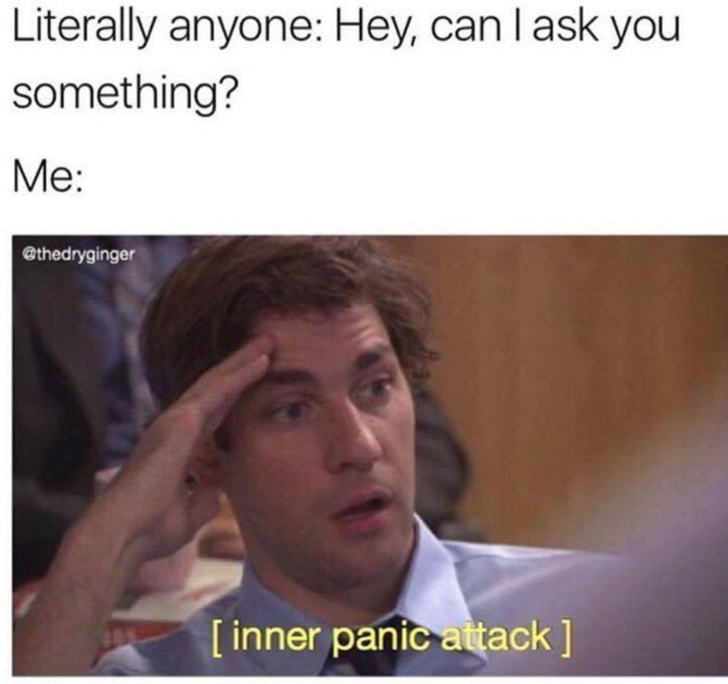
Which responses were more thorough?
Our activity (while a little silly) demonstrated a hidden advantage to asynchronous online tutoring. In some cases, tutors are able to give more thoughtful feedback to student writing and more thorough responses to questions or concerns.

Slide 6

Activity!!
This one is a little more serious, I swear
Acting is encouraged ☺

Slide 7



What did this activity highlight?
The biggest advantage of asynchronous online tutoring is that it expands access to writing center resources.
In scenario 1, the professor was unable to offer the student resources that accommodated their situation, and they ended up at a disadvantage compared to their peers.
Alternatively, the student in scenario 2 was connected with the resources she needed to be successful.

Slide 8
Need for Further Research
Denton is NOT arguing that asynchronous online tutoring is always appropriate.
  There are plenty of valid concerns with asynchronous online tutoring:
    Doesn’t allow for much back and forth dialogue
    Minimizes ability to connect with the student personally/can’t read in person cues like tone or body language
    Hard to avoid the “drop-off center” problem
What she is arguing is that Writing Center scholars need to turn their attention towards researching the efficacy of newer platforms and methods for writing instruction.
She advocates that Writing Center methodology should place less emphasis on tradition and experience, and more on research and evidence.

Slide 9
Online Writing Labs
Chapter 5
By Diane Martinez and Leslie Olsen
Online Writing Labs (OWLs) need to mirror the needs and expectations of the institution.
For example, a school like Trinity where students are residential it makes sense to concentrate efforts into a physical writing center. At a community college that has many students taking online courses, it makes more sense to have an extensive network of online resources and tutoring opportunities.
The authors stress that online tutoring should be available in whatever formats instruction is available.

Slide 10
How to Run an Effective OWL, According to Martinez and Olsen
Accessibility: The authors recommend cultivating an online environment that is inclusive of every student; disability, background, or learning style should not preclude anyone from being able to get the support they need. This might mean taking a multimedia approach and expanding your resources from only written materials.
Pedagogy: While there is obviously a common thread that runs through every mode of writing instruction and tutoring, it is important that we acknowledge that pedagogical techniques are not one-size-fits-all.
Tutor Selection: Martinez and Olsen emphasize that online tutors must be eager to work online, and meticulously trained in their mode of instruction.

Slide 11
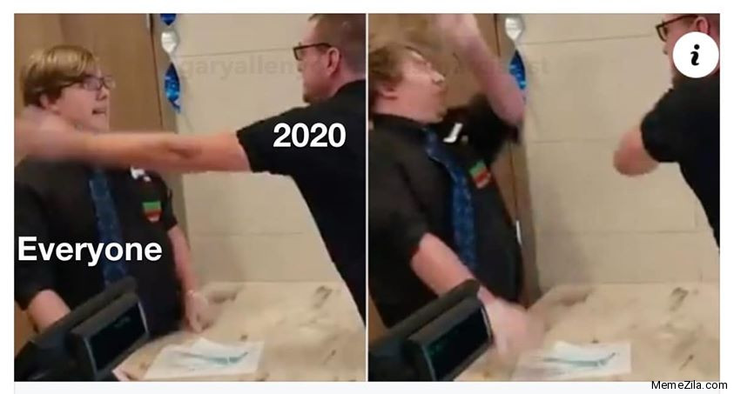
Well that all sounds great… but what if a pandemic suddenly forces everyone online?
How can we reach students who may be struggling with online learning?
How can we avoid bringing our own misgivings about online tutoring into our sessions?
What can we apply from the reading to the transition we are currently making here at Trinity?
Are there aspects of this online semester that might actually improve future accessibility to writing center instruction?

Slide 12

Thanks for listening!

