Slide 1
Proofreading and Punctuation
Sara Lambert

Slide 2
“We don’t proofread here”: Re-visioning the writing center to better meet student needs
Notes:
I’m going to begin by discussing Joan Hawthorne’s article “‘We don’t proofread here’: Re-visioning the writing center to better meet student needs” from The Writing Lab Newsletter.
I didn’t notice the pun in the title until I was working on this presentation, so I don’t know how many of you noticed. Re-visioning as in reimagining but also as in revision!

Slide 3
Joan Hawthorne
Writing from the experience of being the director of the University of North Dakota Writing Center
Reflecting on experience of attending Midwest Writing Centers Association conference
  Presentations: “unspoken understanding… that tutoring is about improving the writer, not the writing” (1)
  One-on-one conversations: “‘Of course the paper is important’” (1)
Confronting the traditional idea of what writing centers do created by lore readings like North and Brooks
Notes:
I always find it helpful to begin thinking about a reading by understanding who the author is and what they’re trying to do.
Writing centers do proofread because it’s an issue that is important to both students and teachers… they just don’t like to talk about it. Hawthorne refers to it as a writing center taboo.
This reading is building on the conversation we had last week about the dangers of writing center lore. The idea that tutoring is about the writer and not the writing has become ingrained in tutoring practices. Hawthorne is challenging that assumption and the practices it has created in her writing center.
She concludes that these simplified answers cannot provide an adequate framework for the complex, variety of issues that arise in writing centers.

Slide 4
“We don’t proofread here”
Hawthorne wanted to address the issue with the conversation that tutors often had with students when they came in
Shifted from “‘we don’t proofread here’” to “‘we’d be happy to take a look at your paper with you’” (2)
Students use the language of proofreading to ask for help because “they lacked the vocabulary and/or experience to know what they really needed” (2)
Draws on Nancy Grimm: “consider who is advantaged and who is disadvantaged by standard tutoring practices” (3)
Notes:
Hawthorne disliked the negative language of the first response. She believed all students were hearing was no and rejection is a hard thing to hear right from the get go especially if it’s someone’s first time into the wc.
I’m the kind of person, who after a long presentation or training etc, can never come up with a question to ask. I know that there are things that I don’t know or didn’t understand, but I never know where to begin with asking for help. There are students who have the same problem when it comes to their writing.
Privileged students are rarely affected by the policies that writing centers adopt because they are already well placed to succeed.
Inexperienced writers that lack the vocab/experience to know what they really want/need from a tutoring session are only a small part of those disadvantaged by traditional tutoring practices and language. Other groups that Hawthorne names as being influenced by writing center policy include first generation college students, Native Americans, immigrant Americans, working and welfare class students, painfully shy students, etc. They are why she takes this question of who their writing center is and what it does so seriously.

Slide 5
Case Studies
Natalia: an ESL student concerned with editing
100 junior-level finance students visiting the writing center because their professors are offering extra credit
Jason: a traditional writing center appointment
Variety of appointments and experiences led to development of training program
Notes:
Natalia wants to sound like an american and therefore mostly needs help finding the appropriate syntax
The tutors lacked the topical expertise to sort out the good ideas from the bad ideas in the finance papers. They mostly found themselves helping students work towards clarity. They were at their most helpful regarding editing and proofreading issues.
Jason’s appointments dealt with idea development, organization, thesis writing. It did not bring up any difficult questions about writing center ethics and pedagogy.

Slide 6
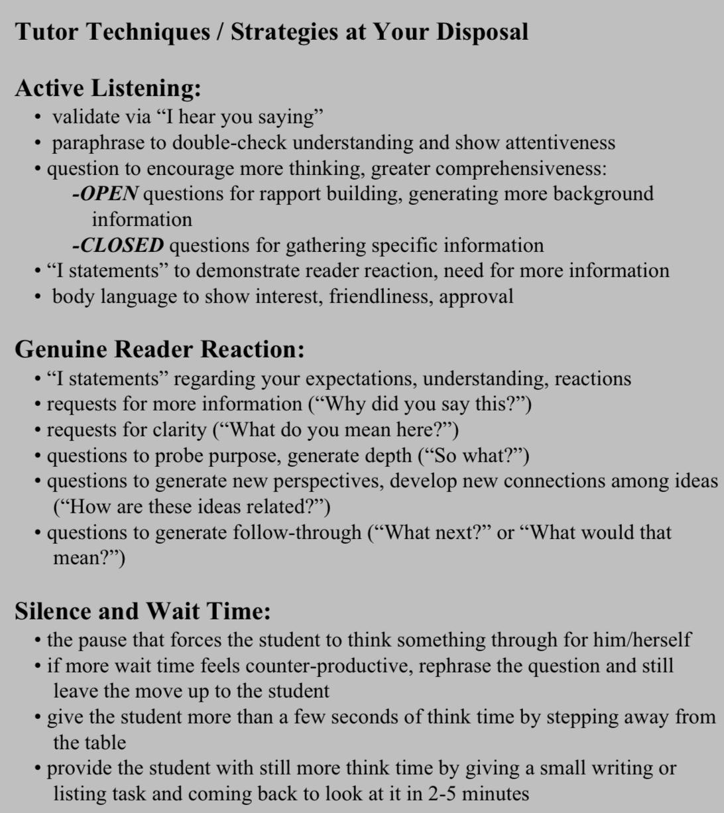
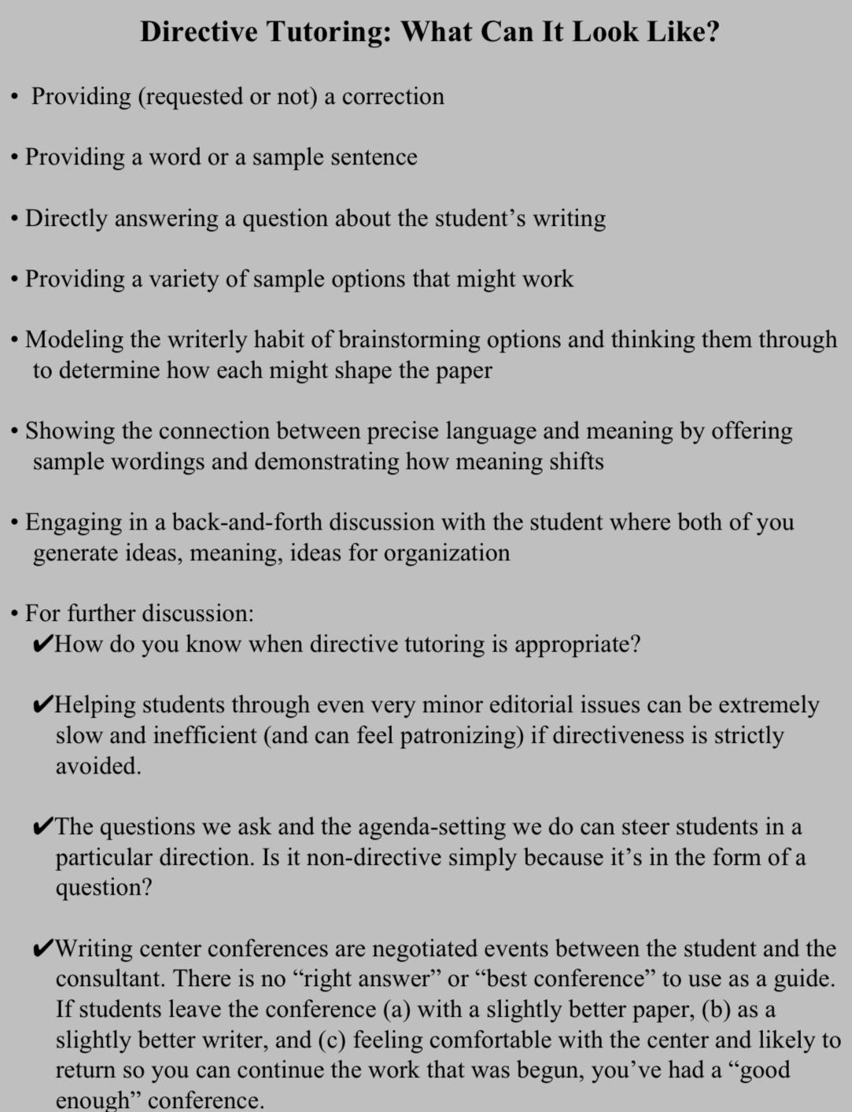
Traditional Tutoring vs. Directive Tutoring
Notes:
Proofreading often requires a more direct approach, so Hawthorne teaches students how to apply such strategies to proofreading issues.
Hawthorne expects her tutors to rely mostly on traditional tutoring strategies and decide for themselves when it feels appropriate to take a more direct approach.

Slide 7
Course of a Tutoring Session
1
Develop Rapport: introduction, simple conversation about assignment
4
Closure: pull back, make sure they know where to go next, find out if they need anything else before the end
2
Negotiate Agenda: What brings them to the writing center?
3
Work on Paper: heart of the conference
Notes:
This is how Hawthorne explains tutoring sessions should proceed
She lays this process out in order to argue for collaboration in the process of editing a paper. If steps one, two, and four all allow and encourage active and collaborative discussion, why would the heart of the conference cut off the collaborative process?
The more flexible pedagogy of her writer center allows for greater collaboration.

Slide 8
Punctuation
Punctuation is “a way to make meaning” not just a complicated system of rules (180)
The writer that fails to punctuate correctly is “having trouble expressing relationships among ideas properly” (177)
Punctuation helps the reader “predict meaning by telling them when to expect an idea to continue and when to assume that it has been completed” (177-8)
Writers cannot correctly punctuate for several reasons:
  Do not focus on it because they are novice writers and are focused on other basic composition
  Attempt to punctuate by ear and do not understand that that “punctuation hinges on grammatical rather than rhetorical structures” (178)
  Attempt to apply rules that misunderstand or misremember
  Do not understand how punctuation marks function

Slide 9
Strategies to Help Writers with Punctuation
Approach punctuation errors as a way to “help a writer explore alternate ways of relating ideas, not as an occasion for fixing up ‘mechanical’ errors” (180)
Oral reading
  Read something several different ways and ask writer how they intended it to be read
  Does not work for everyone because some writers cannot distinguish speech rhythms
Exercise in which writers “are asked to punctuate an unpunctuated sentence aloud” (181)
Asking questions and doing exercises
Notes:
Fixing punctuation errors would likely fall under what most would consider to be “proofreading” and “fix-it” work
The Practical Tutor workbook instead connects it the important and traditional work that writing centers do in helping students express their ideas
Oral reading is useful for “assessing a writer’s understanding and illustrating the functions of punctuation” (180) Be careful not to embarass writers by illustrating how they are misleading readers.
I cannot clap to the beat of music and some writers cannot distinguish speech rhythms.
These are questions that the tutors ask in the example conversations between tutors and students

Slide 10
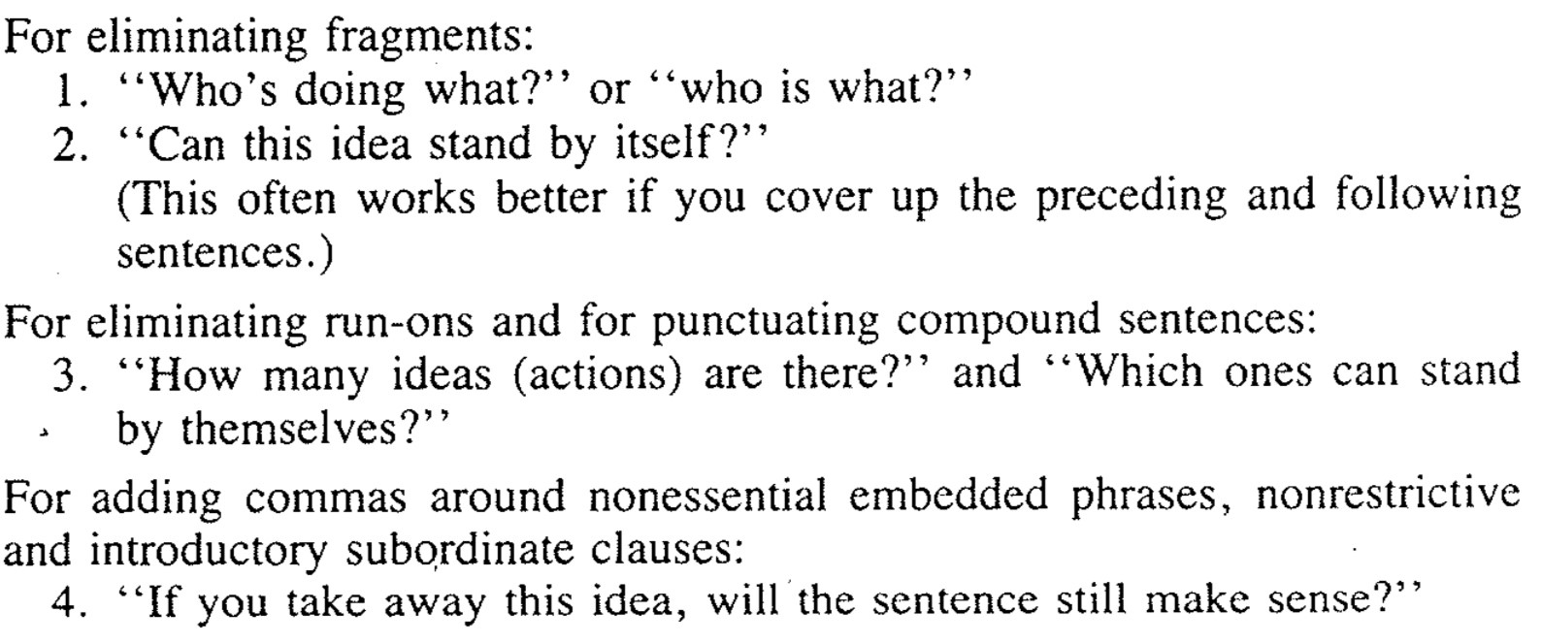
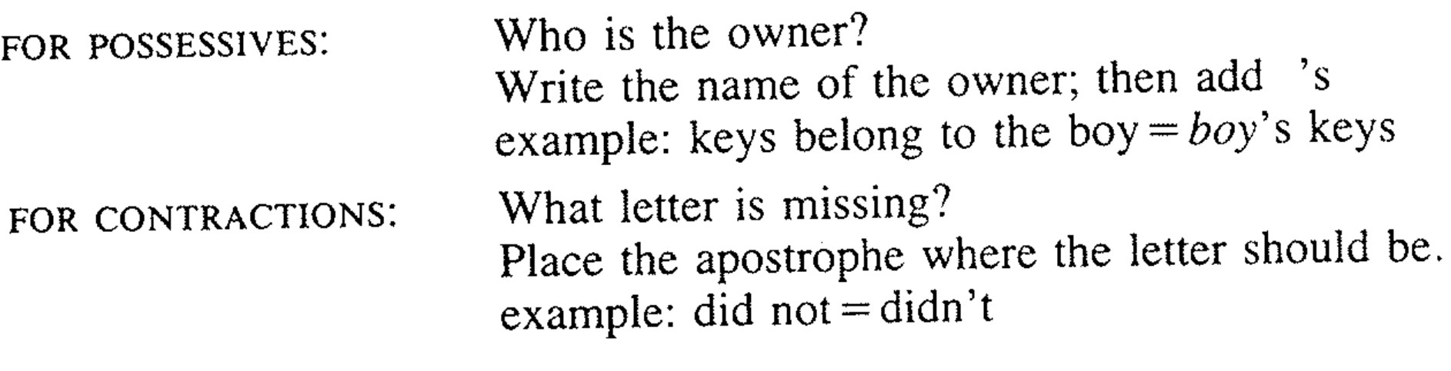
Asking Questions

Slide 11
Tips for Working on Punctuation with Writers
Be adaptable with your strategy based off the needs of the student
Forcing students to answer questions in a specific, predetermined order “may obstruct their independent thinking” (190)
Use yes/no questions when writers are attempting to understand a specific system or convention
Use follow up/open ended questions when generating ideas and to encourage analysis of thought process
Use concrete comparisons to help students understand more complex ideas
Use diagrams
Notes:
In some examples, writers already understand sentence structure and can move straight into punctuation convention
In others, writers need help with basic sentence parts before moving onto punctuation

Slide 12
Kahoot
https://create.kahoot.it/v2/details/a5c751b3-6bea-44ab-bc9e-8c89a23073f7

Slide 13
Discussion Questions
What place do you see proofreading having in the writing center?
For those who have had their first shifts, how have you dealt with punctuation and proofreading? For those who haven’t, what challenges do you anticipate? Which strategies seem most helpful?
How does asynchronous tutoring change the way we help students with punctuation rules and other aspects of proofreading? Which strategies carry over easily and which require adjustments?
Notes:
Hawthorne offers one opinion on how proofreading should be dealt with in the writing center and the Practical tutor offers a new perspective on the value of punctuation because of the way it creates meaning.

