Slide 1
Multiliteracy and Accessibility: New Media Practices in the 21st Century
Rachel Papalski

Slide 2
2% of college students report having a documented learning disability
BUT… it is estimated that about only half of college students formally report their disabilities (Melana Zyla Vickers, 2010)

Slide 3
“Access for All: The Role of Dis/Ability in Multiliteracy Centers”
What is the issue at hand?
  Dire need for repositioning of disability representation in writing center scholarship and tutoring practices
  Viewing disabled students as ‘special cases’ instead of viewing the individual needs of each student
What is needed?
  A universal writing pedagogy that supports multiliteracies and is accessible to a wide range of students
Allison Hitt

Slide 4
Developing a Multimodel Pedagogy: Strategies in Unison
Universal Design
Universal Design for Learning
Jean Kiedaisch and Sue Dinitz:
  “an approach advocating for the design of products and services so that they are suited to a broad range of users” (2)
Includes accessibility in terms of physical space
Framework for designing curricula that enables all individuals alike to benefit and gain knowledge
  Principles: multiple means of representation, actions and expression, and engagement
“Treating each student as different, but not treating students with disabilities differently” (Hitt)

Slide 5
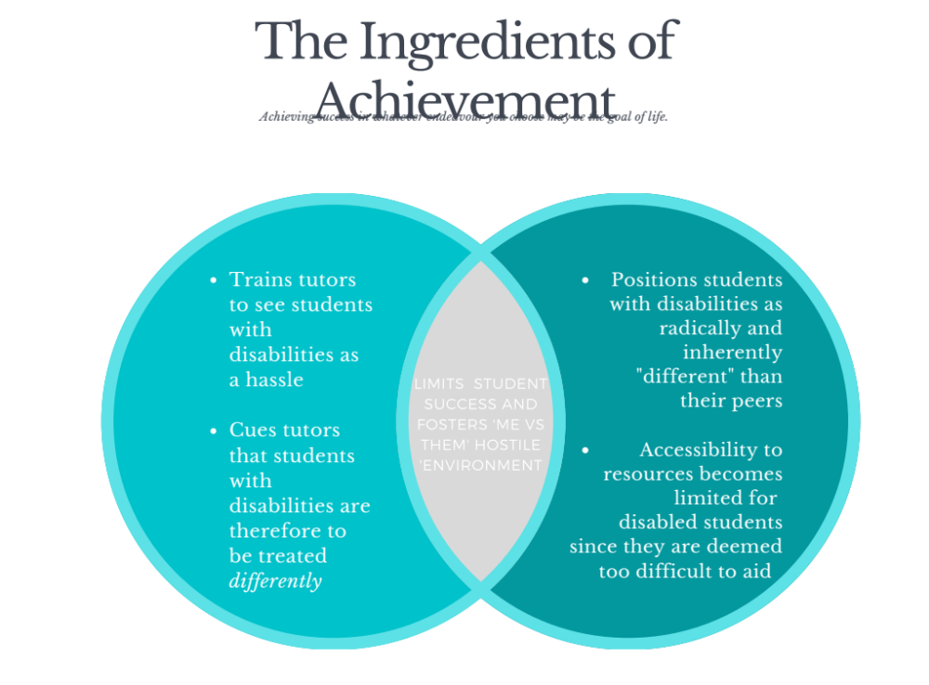
“You can’t accommodate everybody” Mentality
(Sherwood)
“Natural Exclusion” of Disability
(Titchkosky)

Slide 6
Developing a ‘Multimodal Toolkit’
Multimodal pedagogy- visual, aural, gestural, spatial, and multimodal (28)
Combination of visual, auditory, and kinesthetic techniques (multisensory approach) can help cater to needs of every student
  EXAMPLE: a webpage, in which elements such as sound effects, oral language, written language, music and still or moving images are combined

Slide 7

Visual, Auditory, & Kinesthetic SURVEY:
https://psychologia.co/perception-test/

Slide 8
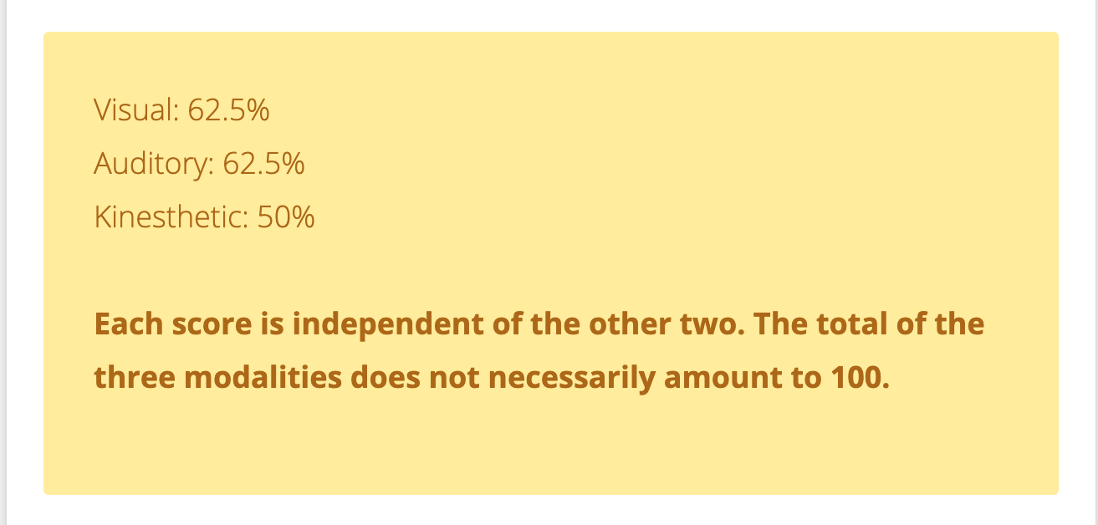
My Results →
Looking at your own results…
-Awareness
-Application

Slide 9
“New Media Matters: Tutoring in the Late Age of Print”
Media has expanded past the traditional, comfortable text / paper format
  Uncertainty to produce ‘new media’
  Fundamental change in textual climate
Shift to these differing modes of media and communication
Jackie Grutsch McKinney

Slide 10
What is New Media?
3 Definitions.
Cynthia Selfe: new media is digital
  “Texts created primarily in digital environments, composed in multiple media, and designed for presentation and exchange in digital venues”
Anne Wysocki: any text that in its production calls attention to its own materiality
  May or may not be digital
Cheryl Ball: multimodal and digital, but the key characteristic is different modes of argumentation
  “Texts that juxtapose semiotic modes in new and aesthetically pleasing ways, and in doing so, break away from print traditions so that written text is not the primary rhetorical means” (405)
New media discussion would fit into any of these three aforementioned categories

Slide 11
Adjustments of Writing Center Practice
(Based on defined ‘new media’)
Current writing center techniques may conflict with new media practices
  “Hands-off” approach
  Traditional text/ paper format
“Working with students on their new media texts asserts our sake as composing professionals in the new media age” (36)
  Tutors look at the text to see student writing
  Instead of asking tutors to read aloud, talk aloud as they negotiate a text

Slide 12
Madeleine Sorapure in Between Modes: Assessing Student New Media Compositions, writes,
“Focusing assessment on the relations of modes might alleviate part of what Yancey described as the “discomfort” of assessment: that part that comes from our sense that we are not the most qualified people on campus to judge the effectiveness of the individual modes of image, audio, or video in a multimodal composition. But I think we are indeed qualified to look at the relations between modes and to assess how effectively students have combined different resources in their compositions. (4)

Slide 13


Slide 14


Slide 15
Overall Tips for Writing Associates
Adapt to students’ different embodied practices
Familiarize yourself with/ have a basic understanding of differing platforms
  Both in terms of disability accessibility and new media practices
ADAPT and adjust as needed!

Slide 16
Discussion Questions
How can we further implement multimodal pedagogy in our own writing center? What are our current employed methods?
What can we, as writing associates, do to reject the ‘natural exclusion of disability’ mindset?
How can we make our writing pedagogies more inclusive to diverse student populations?

