Slide 1
“Power and Authority in Peer Tutoring”
Peter Carino
Cassidy McNeeley

Slide 2

Notes:
I know what your thinking, why is there a picture of mean girls on the board in my writing theories and practice class? It’s not just a great movie but actually shows a lot issues regarding power and authority. We get to see Regina George who completely abuses her power and therefore runs the high school she attends. This may seem pretty great but everyone secretly hates her. We also see Cady, who becomes power obsessed as she attempts to befriend Regina and the plastics eventually leading to her popularity downfall and losing her true friends. Similar to as we see in mean girls, we as tutors need to remember to use the power and authority we are given properly.

Slide 3
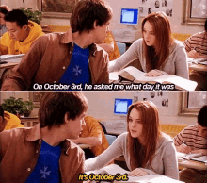

Slide 4
Attempts to sort out
why writing centers have been uncomfortable with holding power and claiming authority
Why they mask these terms with “peerness”
How writing centers might have more success if they refigure authority as a tool in tutorial work
How tutors can be trained to recognize when to use their power and authority and how to do it without becoming an authoritarian
Carino’s Article…..

Slide 5
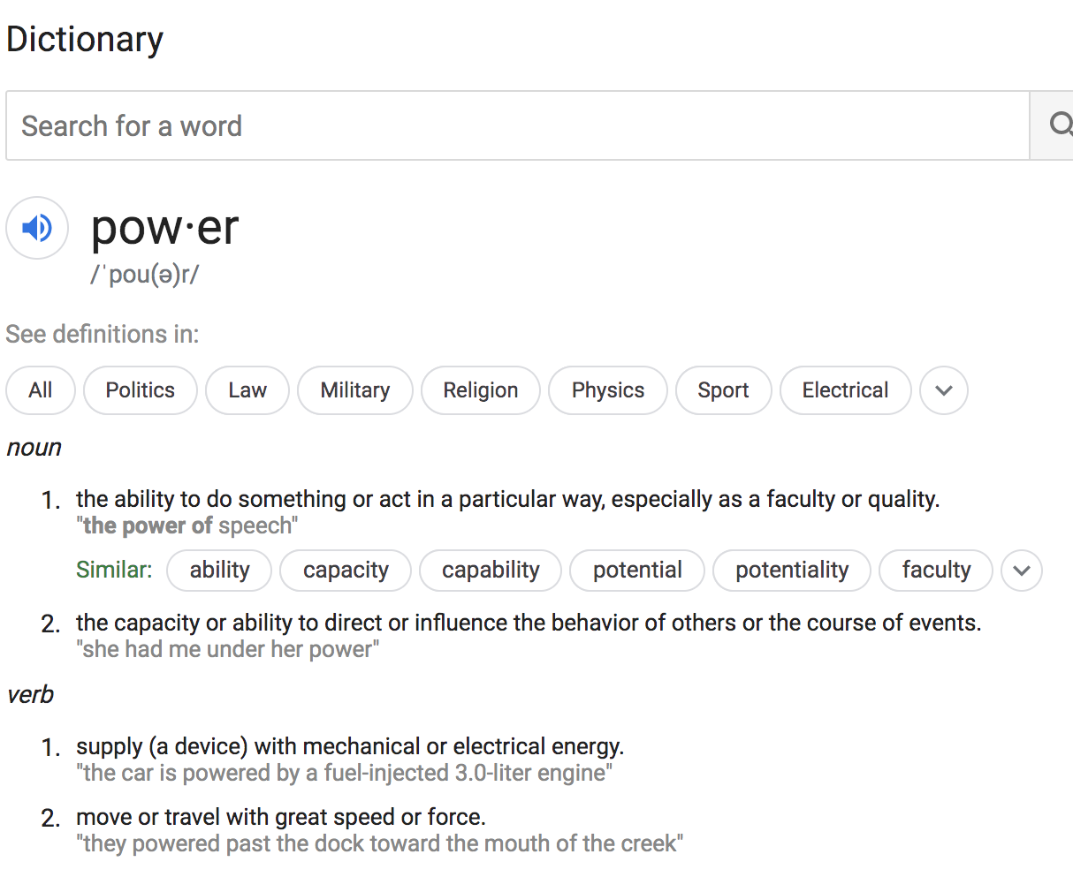
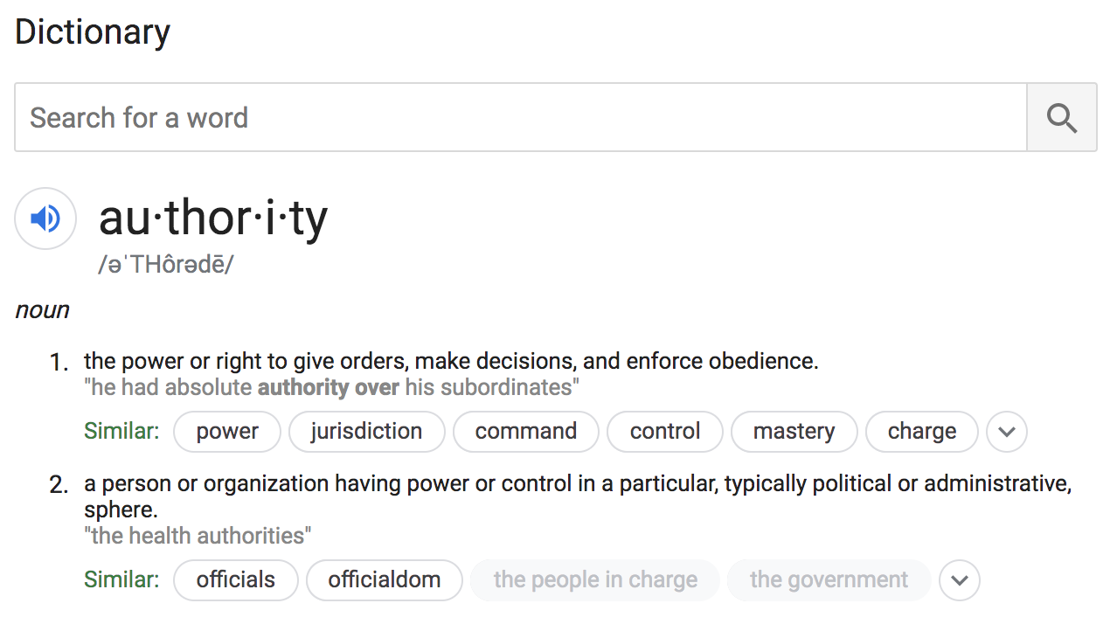

Slide 6

“Power” “Authority”
Not “nice” words
Writing Centers are known as nurturing and friendly environments
  These words take away from the stereotypical image we have of a writing center

Slide 7
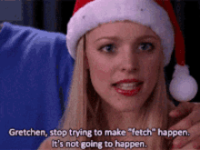
Where did this all begin?
Writing Centers as an institution struggled to gain their own power and authority on college campuses
Many successful writing centers were at the bottom of the hierarchy when they first developed on campus
  Recognize that no one enjoys feeling less empowered
    Want to make students as comfortable as possible
      Do this by not taking an authoritative position, but a peer tutoring model
Power struggle between classrooms and writing centers
Notes:
As we discovered in our first reading, writing centers as an institution have struggled to gain their own sense of power and authority on college campuses
Even though writing centers are more apparent on campuses today, many have faced the challenge of being on the bottom of hierarchical relationships on campus
This has influenced them to take a nonauthoritative position in their work

Slide 8
Classroom vs Writing Center
Debate of who should teach students how to write, the classroom or the Writing Center?
  This authority is usually reserved for the classroom → hold more power
    Credited hours and grades are what colleges revolve around
Writing Centers function more like a minority, recognized as a voice but lack institutional power
Professors argue that their classrooms provide students with the same welcoming and friendly environment, but writing centers have the luxury of not having to give out grades
Notes:
Good and bad
Some students wonder what they “get for” spending their time in the writing center if it is not these credit hours and grades
Some students recognize they will eventually get a better grade by coming to the center to become better writers

Slide 9

Peer Tutoring
How to be a Peer Tutor
Create an equal, reciprocal relationship where trust acts as the basis for sharing work between two people (Thom Hawkins)
“The use of undergraduate peer tutors has powerfully shaped writing center practice for more than twenty years, and the idea of peership has served in center scholarship to represent writing centers as non hierarchical and non threatening collaborative environments most aspire to be” (Carino 96).

Slide 10

Direct Tutoring
Indirect Tutoring
A form of plunder, rather than help
Equivalent to the tutor taking ownership over the students work
Example: grabbing pen/paper, telling student exact correction to make
Can cue students to recall knowledge they have as well as construct new knowledge
  tutor asks questions and the student’s answers lead to an improvement in their writing
Most successful indirect tutoring is when both student and tutor learn from each other
  Directors believe this happens more often than it actually does

Slide 11
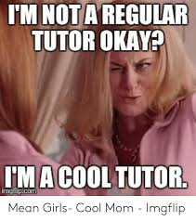
Nondirective tutoring is an antidote for having too much or too little knowledge
  More knowledge- ask questions to ensure your not doing work for them
  Less knowledge- ask questions to draw knowledge of the subject

Slide 12

Activity
Take out your phones!
https://www.surveymonkey.com/r/FK53NSC
https://www.surveymonkey.com/dashboard/

Slide 13
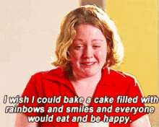
Training should not be nondirective peership but should be flexible
  Tutors should learn to switch between directive and nondirective methods as needed and develop a sliding Scale (110)
Peter Carino
Each student/tutor is different, can not expect all tutors to work the same and all students to learn the same

Slide 14
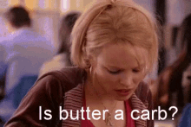
Scholars have began to question the effectivity of “peerness” and indirect tutoring
1995→ Linda Shamoon and Deborah Burns: “A Critique of Pure Tutoring”
    Attacked the writing centers practice of non-directive peer model
      The main argument is that it is not a bad thing that someone has more knowledge and skills than the other sense they are passing this knowledge and skill-set down to them (141)
1996→ Irene Clark and David Healy
  Argue that we need to stop pretending that the tutors do not do some of the work
    This is not plagiarism: no single author, even that of professional writing is fully responsible for their work
1978 → Marcia Silver
  Argues that tutors and writing centers should not have a blind adherence to non hierarchical ethic of peer tutoring

Slide 15
“I believe that peer tutoring should not be dismissed, but refigured in terms of the way authority and power play themselves out depending on the player in any given tutorial” (Carino 102/103)

Slide 16

Carino’s Argument
Tutorials depend on authority and power
  Authority about the nature of writing and power to proceed from or resist what that authority says
    One or the other must have authority, usually the tutor
    Or both must share authority to produce a collaborative peer situation, this is rare
  No matter what techniques are used, both people, or one person, must have the knowledge and occupy the position of power and authority in a hierarchical relationship

Slide 17

Continued
“A non hierarchical environment does not depend on blind commitment to non directive tutoring methods. Instead tutors should be taught to recognize where the power and authority lie in any given tutorial, when and what degree they have them, when and to what degree the student has them, and when and to what degree they are absent in any given tutorial” (109).
From here they decide what technique to use in a session

Slide 18

Continued
“To Pretend that there is not a hierarchical relationship between tutor and student is a fallacy, and to engineer peer tutoring techniques that divest the tutor of power and authority is at times foolish and can even be unethical” (Carino 98).

Slide 19

Some Examples…...

Slide 20
Ideal Peer Tutoring in Nondirect Model
3rd year chem major comes in to go over a lab with a literature major
  Tutor asks the student questions about their thesis placement and lack of transitions
    The student’s answers to these questions influence an improvement in their work
Student takes authority of their work by teaching the tutor about thesis placement in lab rhetoric but also becomes a better writer by learning about transitions from the tutor
Both student and tutor share authority and are engaged in collaboration in order to improve the work

Slide 21
Sticking to a Non Direct Method, Even When it is Not Appropriate
Tutor is a journalism major and theatre minor, working with a student writing a review for a theatre class
Tutor continues to ask indirect questions about the introduction but the student lacks the knowledge of the structure of play reviews to know what they are doing is wrong
Tutor should take the authority and teach them the proper way to write but instead the introduction is left as is and the student does not benefit from the appointment

Slide 22
Recognizing When to Switch to a Direct Approach
Same student and tutor as previous example
This time the tutor draws on their knowledge of journalism and theatre and takes authority to exercise power and direct the student
Does not belittle the student but uses their authority to share their knowledge so that they can help the student properly complete their assignment
Authority is not shared like first example, but there is still a sharing of work

Slide 23
Authority Lacking on Both Ends
Returning back to the first example…
Tutor questions the thesis but this time the student just moves it to where the tutor thinks it should be even though they are not familiar with lab reports
  Student is misdirected
Student should have had power to resist the tutors suggestion

Slide 24
Summary of Examples
Student had knowledge and needed it drawn out of them by the tutor’s questions
The tutor had the knowledge but withheld it from the student and did not correctly use their power/authority
Tutor had the knowledge and exercised authority to share it with the student
Neither student or tutor has knowledge and the appointment went poorly

Slide 25
Discussion Questions….
What have your experiences with power and authority in your sessions been like? Do you find yourself talking a more direct or indirect tutoring method?
Do you think students see us as authoritative figures or does the nonhierarchical environment really diminish this identity?
How does being online impact roles of power and authority in Writing Center?

Slide 26

Thank You!
Carino, Peter. “Power And Authority In Peer Tutoring.” Center Will Hold, pp. 96–113., doi:10.2307/j.ctt46nxnq.9.

