Slide 1
How to Be an ESL Tutor
Common Errors and Techniques

Slide 2
OBJECTIVES
Understand a Chinese students’ ESL learning experience
Learn the common types of word choice errors
Learn the common techniques on how to correct common errors

Slide 3
First, let’s take a look at a Chinese ELL’s experience…
There is a lack of rigor in foreign English classes, which may have consisted of memorization and grammar tests
Differences between structure and style
Perceptions of Tutor-Tutee roles

Slide 4
WORD CHOICE
The most common error that ESL students make is word choice..
Word choice errors are a natural process of second language learning.
Problematic and erroneous word choices result in the meaning of a writer’s words to be distorted, and therefore their overall message suffers.
MOST word choice errors are rooted in semantics. This reveals how two languages can express the same idea, but are very different when written out on a page.
Writing Associates ARE ESL teachers.

Slide 5
THE 6 TYPES OF WORD CHOICE ERRORS
Translation
Wrong Context
Synform
Idiomaticity
Precision
Register
Let’s take a look, using examples of English as the second language and Chinese Mandarin as the first.

Slide 6
TRANSLATION
Errors resulting from expressions that exist in Chinese but not in English
“They planned on casting bombs to the enemy.”
They planned on bombing the enemy.

Slide 7
Wrong Context
Errors resulting from a lack of vocabulary or incomplete knowledge of appropriate context
As George W. Bush once said…
“I am the decider, and I decide what’s best.”
Or
“She expelled him out of the home.”
*this is the most common mistake for ESL students*

Slide 8


SYNFORM
Errors resulting from sound-alike or look-alike confusion.
Iggy Azalea Azealia Banks

Slide 9

IDIOMATICITY
Errors resulting from not knowing the entire collocation

Slide 10
PRECISION
Using a word that is either too general or too specific for the occasion
“Humans made language to exchange ideas.”
“Humans developed language to exchange ideas.”

Slide 11

REGISTER
Using words from conversational discourse in academic prose

Slide 12

KAHOOT TIME!

Slide 13
TIPS HEADING INTO A SESSION WITH AN ELL
Meta-awareness : be aware of (mis)informed assumptions about your tutee’s abilities
Do not be distracted by the tutee’s goals for the session
Engage in small talk!

Slide 14

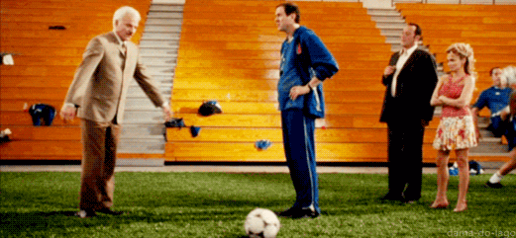
ASSESS WHERE THE WRITER IS NOW
Avoid sermonizing, instead gauge the writer’s level of understanding of a specific concept of their writing
Ask questions to make the interaction collaborative. This avoids making the tutee uncomfortable and skewing the objectives of your session.

Slide 15
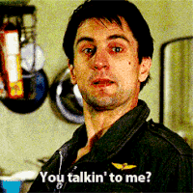
BE DIRECT
Prioritize direct speech over “polite” rhetoric (hedging or leading questions)
Model specific examples for your tutee
Give answers to technical issues

Slide 16
BE TRANSPARENT
Completely reveal why you made a correction
“transparency from the tutor will encourage the ELL writer to direct the consultation by increasing the writer's "metacognitive awareness" about consultation strategies. Tutors need to show ELL writers that tutors are certainly not perfect when it comes to giving suggestions or running consultations and that writers are encouraged to make suggestions or queries” (Frances Nan 57).

Slide 17
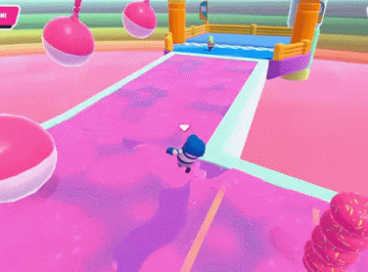
NOTICE BODY LANGUAGE
Both ELL and tutors can use body language as a supplementary tool
This can inspire the tutor to ask more follow questions to gain clarity

Slide 18
EVALUATE
Ask for the tutee to demonstrate a concept/skill in order to gauge their level of understanding
  Note taking
  Mirroring
  Problematize a correct answer
  Pursuit questions

Slide 19
DISCUSSION QUESTIONS
How can we analyze and reimagine the WA hiring process to fit the needs of ESL students?
Can some of these techniques be used for native English speaking students as well?
Has anyone experienced these issues of word choice errors or have been able to apply these techniques in your own tutoring sessions?

