Slide 1

Working With Learning Differences in the Writing Center
Summer Dow
November 7, 2019
This Photo by Unknown Author is licensed under CC BY-NC

Slide 2
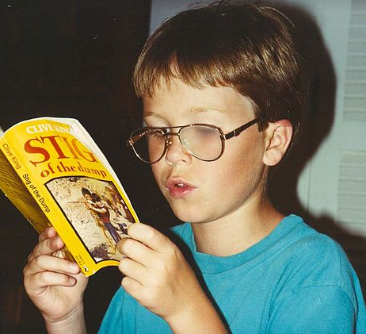
Dyslexia
Sally E. Shaywitz
Scientific American (November 1996)

Slide 3
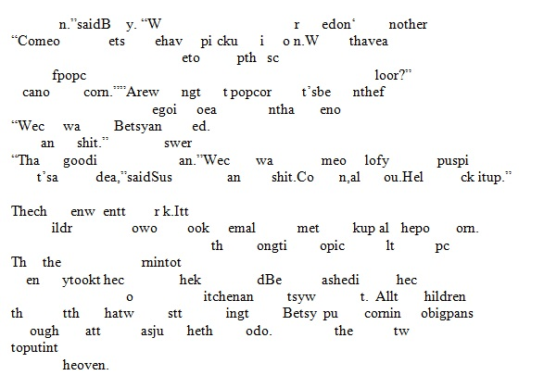
Preconceptions about Dyslexia
What are your impressions on how individuals experience dyslexia?

Slide 4

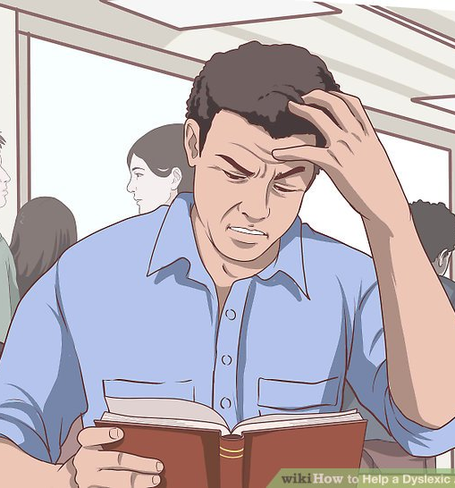
What Dyslexia is NOT
Dyslexia does not present the same for everyone, every brain is different.
Individuals with dyslexia don’t write letters backwards and/or read words in reverse.
There is no connection between intelligence and dyslexia.
Individuals with dyslexia can become excellent readers.
Dyslexia is more common than you think, it presents in about 1 in 5 people.
Accommodations are not an advantage; they level the playing field. “Fair” means everyone gets what he or she needs to be successful.

Slide 5
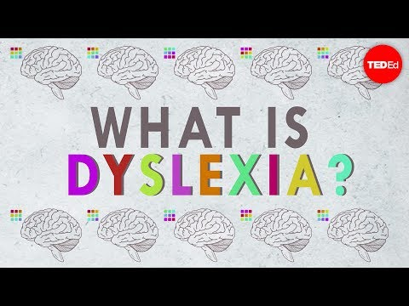
Quick Video

Slide 6
Phonological Processing
What your brain does when reading or writing involves phonological processing
Phonological processing: ability to see or hear a word, break it down to discrete sounds, and then associate each sound with letter/s that make up the word.
The brain processes language in a series of components devoted to a particular aspect of language

Slide 7
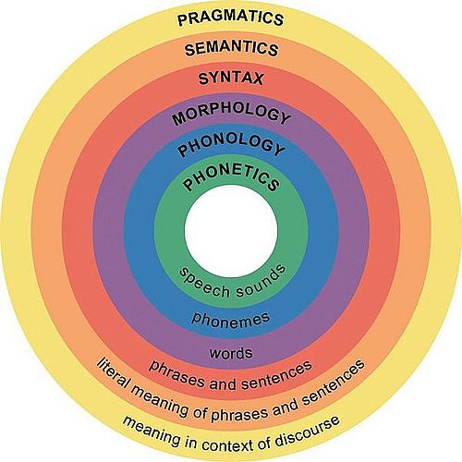
The Phonological Model
Upper Level: Components involving
Lower Level:
Semantics: vocab and word meaning
Syntax: grammatical structure
Discourse: connecting sentences
The Phonological Module: processes each unique sound that makes up a language

Slide 8
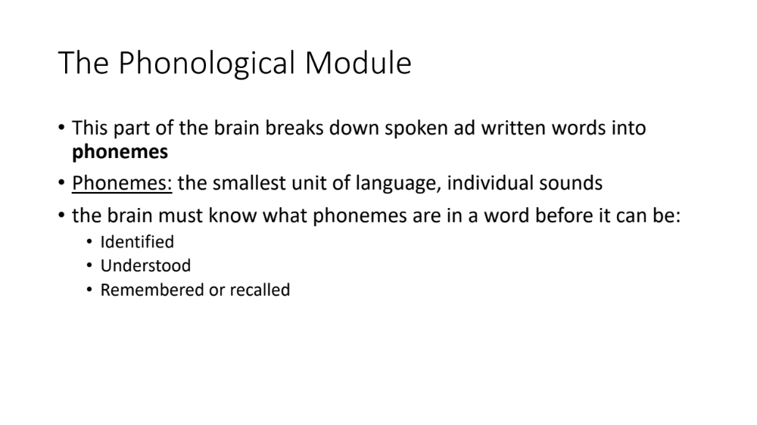
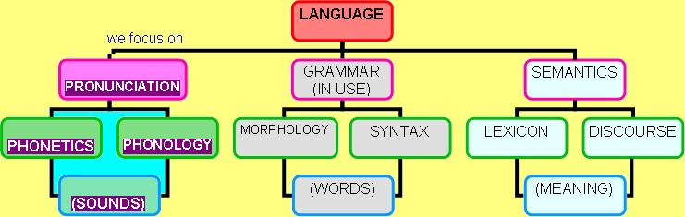
The Phonological Module
This part of the brain breaks down spoken ad written words into phonemes
Phonemes: the smallest unit of language, individual sounds
the brain must know what phonemes are in a word before it can be:
  Identified
  Understood
  Remembered or recalled

Slide 9
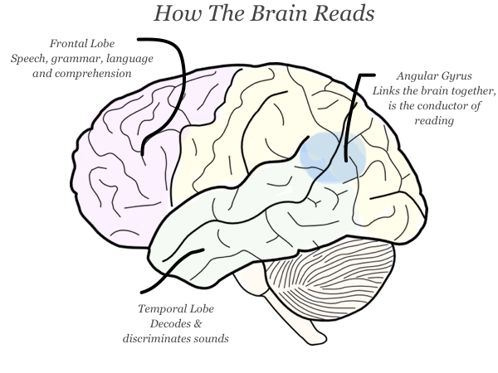
How the Brain Reads
Speaking is instinctual for most people
Reading is an intention that is taught and learned at a conscious level
To read, the brain must
assign sounds to letters
Organize the sounds to the order
they are placed

Slide 10
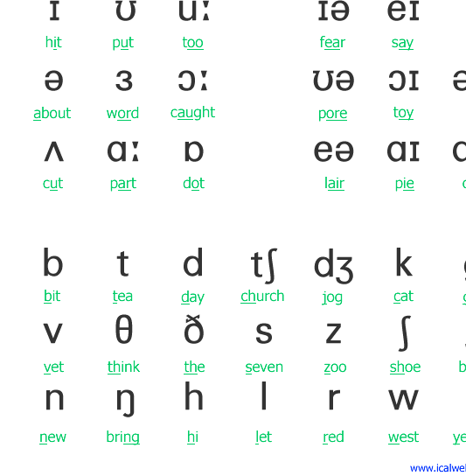
Phonetic Transcription Activity
The IPA (International Phonetic Alphabet) catalogs and assigns a symbol to every sound used in the human language.
This image shows every symbol used in the English language
Using these symbols, practice writing the sentences on your handout.
Notes:
Add IPA to handout

Slide 11
Answers
He still lives in a big city // hi stɪl lɪvz ɪn ðə bɪg ˈsɪti
I like miles of bright lights // aɪ laɪk maɪlz ʌv braɪt laɪts
They sell ten red pens for a penny // ðeɪ sɛl tɛn rɛd pɛnz fɔr ə ˈpɛni
Sue threw the soup into the pool // su θru ðə sup ˈɪntu ðə pul
Don’t stroll slowly down a lonely road // doʊnt stroʊl ˈsloʊli daʊn ə ˈloʊnli roʊd

Slide 12
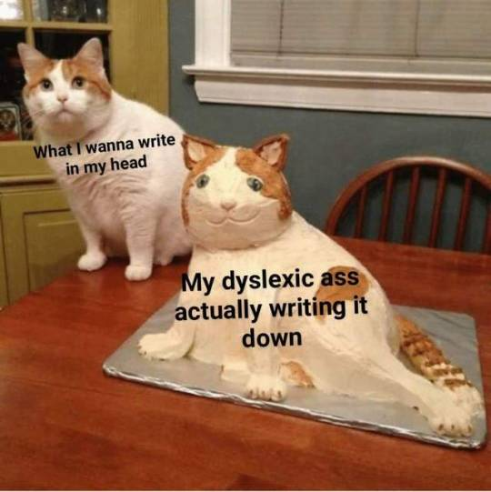
The Phonological Model for Dyslexics
A dyslexic brain cannot process sounds that make up spoken and written words correctly
In dyslexia, a lower level linguistic function blocks higher order processes to gain meaning from text
there is a deficit in the lower level of language functioning
The phonological module functions differently, preventing the written word to be identified and broken into each sound
This impairs how the brain decodes, preventing word identification
Therefore, the higher-level functions the brain requires to read function properly, but “cannot be called into play”
They only work once a word has been identified
brain

Slide 13

Putting it in Context
Dyslexic brains work differently than those without:
Significant strengths: reasoning, problem solving, concept formation, critical thinking and vocabulary.
Weaknesses: rote memorization, rapid word retrieval

Slide 14
Recognizing Students with Dyslexia in the Writing Center
Misnaming objects
  Typically replacing the correct word with one of similar meaning or similar sound
Decoding requires a lot of mental effort for compensated dyslexics
They aren't automatic nor fluent in their ability to identify words.
Reading requires an enormous use of resources and energy
Dyslexics will pepper their speech with many um’s, ah’s and other hesitations

Slide 15

Apprenticed to Faliure: Learning from the Students We Can't Help
Steve Sherwood
The Writing Center Journal (Fall 1996)

Slide 16
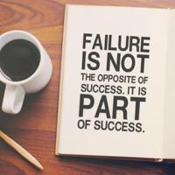
Our Failures as Peer Tutors
approach setbacks as learning experiences
"A good failure challenges our technique, deflates our confidence in being able to help every writer we meet, and goads us into learning more about our diverse field to avoid repeating mistakes."

Slide 17
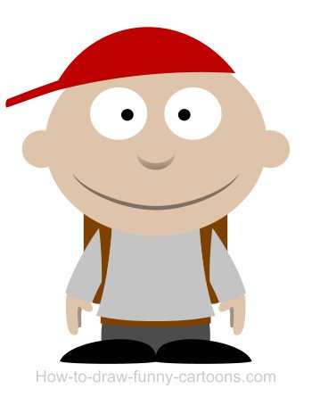
Conversation with a Student
Why do you come into the Writing Center?
Spelling
Grammar
Clouded Ideas: “my ideas are not always coherent or directed to address a single point”
“Sometimes what I think I am saying and what the paper is saying are two different things.”
“I come to the writing center to work on my writing, but also to be a better writer.”

Slide 18
Conversation with a Student
What works in our sessions?
“I like when we have a thorough discussion on my intended topic of the paper and the direction I want to go before looking at any writing I have brought in.”
  What tutoring methods would you describe this as?
”Having you read out loud is great, it allows me to be able to recognize my grammatical mistakes and find sentences that don’t flow.”
I love it when you ask a lot of questions.”
“I like it when you type when I am talking about big ideas or ways to change a sentence, I can’t always write the way I speak.”
“When I am having a hard time organizing my paragraphs, making a paper outline has helped in past sessions”

Slide 19
"Failure is a key to our growth as tutors"------ --Discussion
Taking what we know about how dyslexia works and the pedagogies we have learned over the semester, take 5 minutes and share with people around you about an experience you may have had tutoring someone with LDs.
  Did you recognize if the student had LDs?
  What in your session made you think that?
  Did you personally feel equipped to provide the tutoring that was needed to help the student?
  How did you feel the success of the session went?

Slide 20
Discussion cont’d - Adapting Our Own Pedagogies to Support Students with LD's
As a class, let’s collaborate and come up with some approaches that can be helpful when working with students who have dyslexia.
Use the descriptions/examples in your handout of all the different students in the readings to come up with ideas.

Slide 21

Remember to Keep Changing!
"Greater knowledge often brings about greater awareness of fault, keener awareness of shortcoming, and more acute senses of inadequacy"
“[w]hen we are no longer able to change a situation... we are challenged to change ourselves"

