Slide 1
The Writing Lab Newsletter
Training Tutors in Emotional Intelligence & Preparing for Emotional Sessions
Katherine Devaney
3 October 2019

Slide 2
Preparing for Emotional Sessions
“For some, deciding to “be tutored” is not simply scheduling time in a busy day before turning in a paper. It’s an act of will that engages the stomach and the heart, which is churning with uncertainty and fear, which is hopeful that the paper conveys something true” (Mills 1).

Slide 3

Being Evaluated
The student may feel intense fear of being evaluated and judged by writing associates, especially if they have been negatively criticized in the past.
We must remind ourselves of how difficult the writing process can be, especially when coupled with the fear of criticism (Mills 3).
Notes:
It is so easy for us to become comortable with our own jobs, and forget that the student may feel very uncomfortable

Slide 4
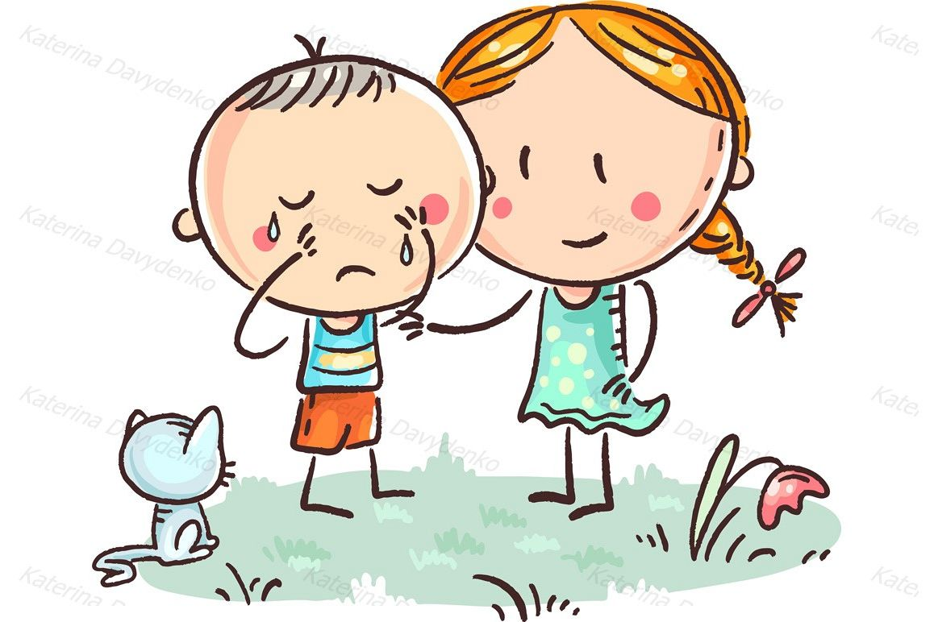
When the Paper is Personal
How should a tutor address the contents of a paper when the writing reveals secrets, confusions, and anxieties of the writer?
Developing a clear goal for the session can distance the student from delicate subject matter, and help stay focused (Agostinelli, Poch, Santoro).
“Some students don’t want your sympathy; they just want help with their writing” (Hongis).
Guys, Gals, and Tears
Properly handling a crying student is a task that everyone is capable of, regardless of gender.
  Why do I say this?
If a student becomes physically emotional, it is best to allow them to explain their frustration, or to let them take a break and come back to the session.
  Avoid constantly redirecting them to their topic, as it may irritate them further (Mills 3).
Notes:
*Some argue that avoiding emotions all together by remaining professional and detached is the best way to deal with such situations
This can be inhumane and ineffective
*Misconception stated in the article about females being more apt to cry in public and therefore better at dealing with tears

Slide 5
Learn from One Another
Learning Together
Learn from the experience of other tutors and from your own observations.
Anger, stress, anxiety- The three most frequent and troublesome emotions that exist in appointments.
  Talk with others about how they have approached such emotions in the writing center!
Ways to Respond
Determine the intensity of the emotion, react accordingly.
  Respond with empathy and professionalism (Mills 4).

Slide 6
Training Tutors in Emotional Intelligence: Toward a Pedagogy of Empathy
Daniel Goleman’s 5 Aspects of Emotional Intelligence
Ability to recognize a feeling as it happens.
Ability to soothe oneself so as to manage distress.
Ability to “marshal emotions in the service of a goal”.
Ability to empathize or “attune to the subtle social signals that indicate what others need/ want”.
Ability to “manage emotions in others” in order to create an effective relationship.
Discussion for the Class: Aspects #1, #4, #5
Notes:
4. As it was mentioned prior, some students may not want your sympathy and questioning, best to read the situation to figure it out before jumping to conclusions

Slide 7
Managing Different Students Based off of their Emotion
Managing Emotionally Distraught Students
Emotionally charged sessions can have detrimental effects on both the tutor and tutee’s efforts- making it important to recognize signs early on.
We do not have the responsibility of qualified therapists. Therefore, responding to an emotional writer does not need to mirror a therapy session.
  Instead, recognize, embrace, and respect the dignity and emotions of all individuals.
Managing Angry and Frustrated Students
May appear as defensive, frustrated, embarrassed.
Press at the “core message”.
  Use the formula, “you feel… because….”
  Validate their frustrations, but do not mirror them (Lape 4).
Notes:
Angry- most common
*they may not be communicating what they want to

Slide 8

The Power of Empathy
“Many people just want to feel important and listened to… some people may act difficult if they feel hopeless or powerless”
Empathy and trust are a two way street, they build upon one another to motivate learning (Lape 6).
Video on Empathy:
https://vimeo.com/81492863

Slide 9
Class Exercise
Tutor: Hi! [Smiles] My name’s Chris. We can just sit over here. Grab that chair. What can I do for you?
Writer: Well, I’m Jeremy, and I have this paper [hands it to tutor], and uh, my teacher said, I have to come here and, uh, get some help ‘cause my paper. . . [looks down] was a D.
Tutor: Then maybe we should just begin by reading through it out loud. Do you want to read, or would you rather I did?
Writer: [Motions to tutor and mutters “You,” then folds arms across chest and gazes off into space.] (Lape 3).
Notes:
Go back to David Golemans aspects of emotional intelligence-
*what feelings do you recognize
*what may this student need/want?
*Manage emotions within others-- empathy?

Slide 10
Ways to Practice
***IMPORTANT***
“Training” for emotional sessions is a difficult medium. To reiterate, none of us are trained therapists. Therefore, it is important to remember to do our very best in each individual session and treat each student with equal amounts of decency and empathy.
However, some effective ways to practice for such sessions may be:
Roleplay
Observation and discussion
Reflective journaling (Lape 7).
Notes:
Reflective Journaling- take notes on what you felt you did well, what could have gone better, and how the student reacted

