Slide 1


Requiring First-Year Writing Classes to Visit the Writing Center:
Bad Attitudes or Positive Results?
By Barbara Lynn Gordon
Katie Camuso

Slide 2

Stephen North
“Nor should you require that all of your students drop by with an early draft of a research paper to get a reading from a fresh audience. [...] Even those of you who, out of genuine concern, bring students to a writing center, almost by the hand, to make sure they know that we won’t hurt them---even you are essentially out of line. Occasionally we manage to convert such writers from people who have to see us to people who want to, but most often they either come as if for a kind of detention, or they drift away” (North, 440)
(if the visit is required)

Slide 3
Pros of Required Visits
Reaches more of the student body
Positive reputation
Adds credibility
Can you think of any more?

Slide 4

Trinity Email Sent to Faculty
“As much as I have espoused the view that we can best serve student-writers when they come to the Writing Center of their own volition (i.e. not requiring appointments), some hard research has shown that the stigma of being referred to the Writing Center as an individual student is all but erased when the entire class is required to make several visits as a mandate of the project/course”
-Tennyson O’Donnell

Slide 5
Cons of Required Visits
Long wait times
Hurried conferences
Overcrowded space
What are some cons that you have experienced? How can we improve those appointments?

Slide 6
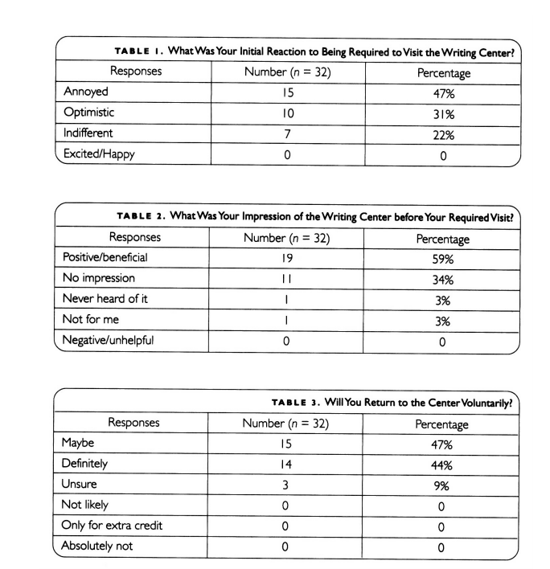


Are these results surprising?

Slide 7
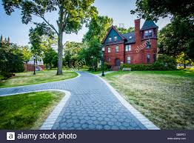
Trinity’s RHET 103 Class Survey:
“What did you find most effective in the professor’s approach to teaching this course?
  “Encouraging students to go to writing center”
What aspects of this class contributed most to your learning?
  “Using the writing center to improve writing.”
What aspects would you like to see stay the same?
  “Mandatory visits to the writing center”
What would you like to see remain most in the course the next time it is offered?
  “go to the writing center more often””

Slide 8


Findings from Other Studies
University of Southern California:
Improved writing after going to the Writing Center
Positive attitudes towards the Writing Center
Bryant University:
Were “forcefully encouraged” to attend
Positive feedback was given
Would not have gone if it was not incentivized
Satisfaction grades were lower when they received their grades

Slide 9
Potential Solutions and Alternatives to Required Visits
Incentives!
Encourage students to bring their work during various stages of writing
Bring the class to the Writing Center to familiarize them
Offer shorter time frames
Have tutors role-play appointments during class time
Thoughts?

Slide 10
“Curriculum-based”
Power
Requirement = controlling
Collaborative center is one where students come on their own
Advertising is not effective when drawing students in, which is where required appointments come into play
(Kail & Trimber)

Slide 11
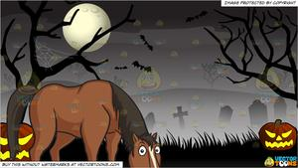
Leading the Horse: The Writing Center and Required Visits
By Irene Lurkis Clark
Katie Camuso

Slide 12
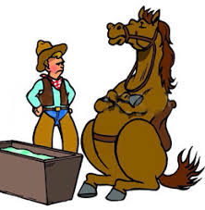
“You can lead a horse to water, but you cannot make him drink”
Student
Professor
Writing Center

Slide 13
Psychological POV
Intrinsic vs. extrinsic motivation in the context of the Writing Center
As a Writing Center Associate, can you tell if a student is intrinsically or extrinsically motivated? If so, what are the differences and how do you approach each situation?

Slide 14
USC Study: Research Design
Statements:
The Writing Center is valuable to my overall writing improvement.
I am too busy to go the the Writing Center.
I am already a good writer and do not need extra help from the Writing Center.
I appreciate getting feedback about my paper from someone other than my teacher.
The tutors in the Writing Center are not helpful.
Teacher requirement of visits per semester (zero, once, twice, three times, or more than three times)
Actual visits this semester (zero, once, twice, three times, or more than three times)

Slide 15
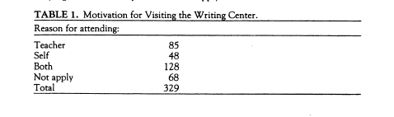
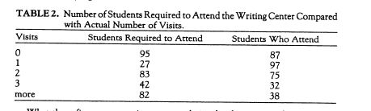
USC Study: Results & Conclusions

Slide 16
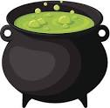
Take Away:
“And with the right encouragement, even the most recalcitrant horse, aware of his thirst and standing at the water's edge, might bend his stubborn neck and take a drink” (Clark, 34).

Slide 17

Final Question:
WITCH side are you on?:
Should required visits to the Writing Center exist?

