Slide 1
Punctuation & “We Don’t Proofread Here”
Emma Sternberg
September 19, 2019

Slide 2
Notecards
Write a question about grammar or punctuation that you have always been curious about or have never felt confident understanding or teaching.

Slide 3
Punctuation Errors
Types of Errors
Aural
Misunderstood or Misremembered Rules
Strategies
Read the sentence out loud; however, do this with caution
Punctuate a new sentence together

Slide 4
Practice: Punctuating a New Sentence
“Its vanished trees the trees that had made way for Gatsbys house had once pandered in whispers to the last and greatest of all human dreams for a transitory enchanted moment man must have held his breath in the presence of this continent compelled into an aesthetic contemplation he neither understood nor desired face to face for the last time in history with something commensurate to his capacity for wonder.”
(F. Scott Fitzgerald, The Great Gatsby)

Slide 5
Practice: Punctuating a New Sentence - ANSWER
“Its vanished trees, the trees that had made way for Gatsby’s house, had once pandered in whispers to the last and greatest of all human dreams; for a transitory enchanted moment man must have held his breath in the presence of this continent, compelled into an aesthetic contemplation he neither understood nor desired, face to face for the last time in history with something commensurate to his capacity for wonder.”
(F. Scott Fitzgerald, The Great Gatsby)

Slide 6
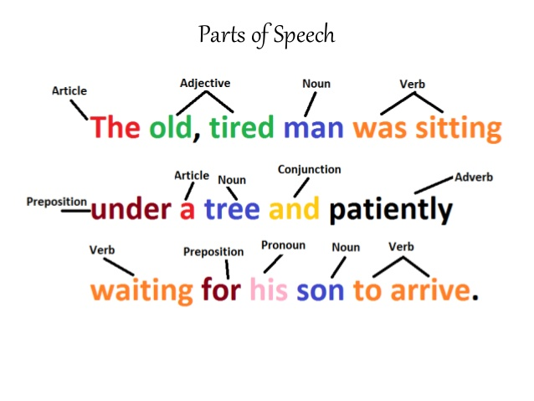
Sentences
Types of Sentence Errors
Fragment
Run On
Parts of a Sentence
Subject
Verb
Coordinator
Subordinator

Slide 7
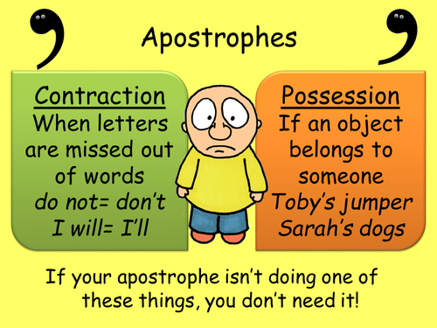
The Apostrophe
The Apostrophe indicates two things
Possession
Contractions

Slide 8
Kahoot
https://create.kahoot.it/details/punctuation-and-grammar/68179c45-af12-4316-a842-3ed612525be6

Slide 9
“We Don’t Proofread Here”
Main Topics
Tutoring Contradictions
Writing Center Cases
Tutor Techniques
Directive Tutoring

Slide 10
“We Don’t Proofread Here” Important Quotes
“Directive tutoring, she told me, was not part of her center’s pedagogy… But I noticed during my observations that her questions were usually chosen with a purpose in mind… How was that different than a more openly directive style of teaching/tutoring/consulting?” (2).
“What do we do in the writing center? What do our choices about what we do mean for us? What do our words about what we do convey to students? Who gets advantaged or disadvantaged by the choices we make? Who do we really serve?” (2).
“We do spend more time on lower-order concerns, if that’s part of the student’s own agenda, than we did when we began announcing that we don’t do proofreading” (6).

Slide 11
Notecards
Time to answer the questions on the notecards.

