Slide 1
Gender in the Writing Center
India Rhodes

Slide 2

Gender and Communication
How would you describe stereotypically masculine and feminine form of communication?
Is one or the other privileged in academics?
The writing Center has been described as a ‘feminized space’
What does this mean?
Do you agree?
Is a ‘feminized’ Writing Center a good thing?
What about in the Writing Center?

Slide 3
Sex in the center: Gender differences in tutorial interactions
Rafoth et.al.
Main Idea:
  Gender is a part of the tutorial, and there should be open communication about the possible effects of gender dynamics.

Slide 4
Introduction
It’s hard to talk about gender.
Stigma around gender discussion, even in class (Quote on Handout)
This article was published in 1999. Do you think this attitude still exists today?

Slide 5
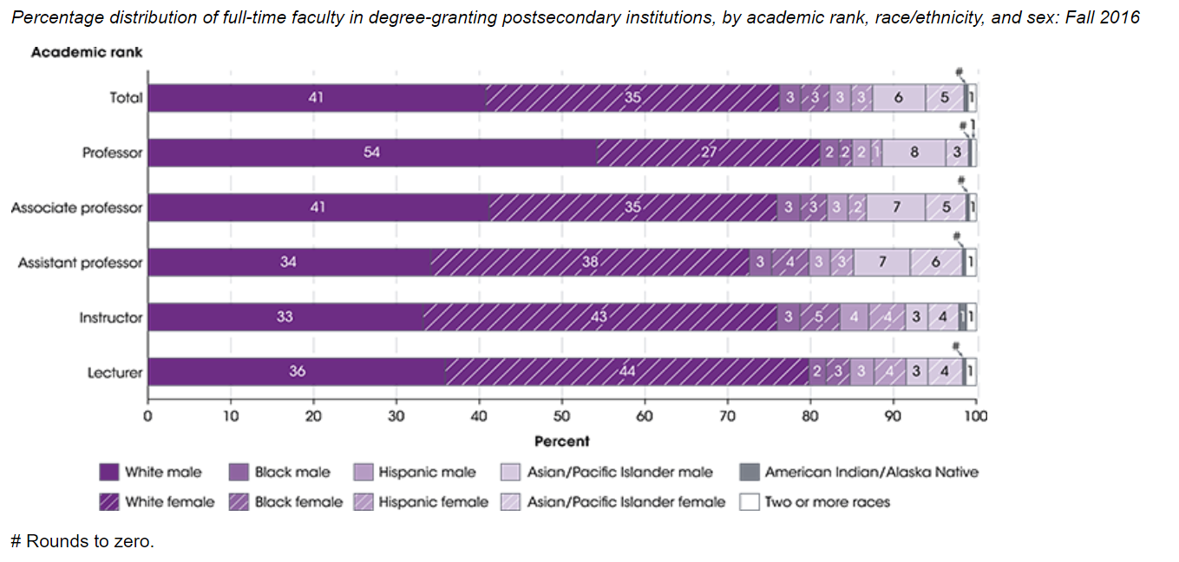
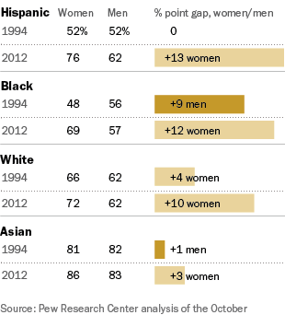
Gender in Colleges

Slide 6
The awareness of gender that we have is grounded not just in some abstract stereotype which society or the media has taught us about what’s masculine and what’s feminine but in the small yet very really characteristics of individual people. At the same time, it cannot be denied that most people tend toward a masculine or feminine identity based in similar characteristics.
Page 2
What does this quote imply about the fundamental nature of gender?
Do you agree or disagree with this statement?

Slide 7
Gender Bias
Baby Examples
Poses of babies in greeting cards
Perceptions of crying
Examples of when girls are privileged over boy?

Slide 8
Does Gender Make a Difference?
The authors question what effects gender could have on a tutorial.
  Tutors at the authors’ own center, question if gender makes any difference at all.
  Do you believe that gender makes a difference based on your personal experiences and beliefs? If so, what is its impact?

Slide 9
Two Perspectives
Deborah Tannen
John Gary
“Communication is a kind of ritual. Men and women talk the way they do because they have been taught, one generation to the next, to talk that way.” (page 3)
  If gendered communication is learned through culture, it can be re-learned in a different way.
Conflicts are based on differences in communication styles
Men and women have fundamentally different needs.
  Women need to be cherished and men needed.
Conflicts are based on men or women forgetting that the other may have a different goal in communication.
The genders are distinctly different and possibly irreconcilable.

Slide 10
What Tutors Say About Gender Based Behaviors
Tutors role-play over-exaggerated versions of different gender dynamics.
  Male Tutor-Male Student: Very task oriented and business-like
  Male Tutor-Female Student: Male tutor dominates discussion
  Female Tutor-Female Student: Lots of discussion, neither wants the conversation to stop
  Female Tutor-Male Student: Student dismissive and unengaged
A group of tutors viewed these role-plays and concluded:
  Gender does play some, unagreed upon, role in the writing conference
  Both parties are responsible for the conference, but the tutor has the ability to guide the session at any time
    “one always has the power to change the status quo in a communicative event” (page 5)

Slide 11
An Informal Survey
Survey of tutors and students from 41 different tutoring session
71% of students and tutors identified the tutor, regardless of gender, to be the one that did most of the talking
Majority of respondents described the relationship between student and tutor as professional
62% of writers and 74% of tutors say gender didn’t make a difference
86% of both writers and tutors say that the session would have been different with different people involved
About 50% said it would have been different with different a different gender pairing

Slide 12
IT’S NOT ABOUT WHAT YOU SAY, BUT HOW YOU SAY IT (AND TO WHOM): ACCOMODATING GENDER IN THE WRITING CENTER
Claire Elizabeth O’Leary

Slide 13

What Research Says About Gender in Communication
Visible social characteristics, like race and gender, partially determine the course of a conversation
Students and tutors manifest gender roles in conversation
Formal v. Informal Conversation
  In formal conversation there is little to no difference in the conversation practices of the authority figure, whether male or female
In teaching situations, the empowered individual will adapt conversation styles to accommodate gender performance

Slide 14
Study
O’Leary wants to examine if the same rules for conferences between professor or graduate-student-tutors and peer-tutors
Author observes 4 conferences with 2 female tutors in a “neutral” setting
‘Anna’ and ‘Rich’ / ‘Jillian’
‘Jane’ and ‘Benjamin’ / ‘Alexis’

Slide 15
Results
Anna and Rich Less formal More talk-time Less self-doubt Both a masculine (assertive) and feminine (active listening) traits | Anna and Jillian Less formal Less talk-time More self doubt Assumed a more feminine conversation style (have power to Anna)
Jane and Benjamin More formal Underprepared and unwilling to work Combative conversational style More masculine style of conversation with authority | Jane and Alexis More formal More prepared, and willing to follow Jane’s lead Friendlier tone More feminine style of conversation in deferring to Jane

Slide 16
Conclusion
Writing-fellows do make accommodations based on gender performances
This is even more true of informal conferences
Talking about gender performance in writing conferences may help to identify techniques that accommodate gender, without recreating gender norms. (Quote on Handout)
What are some techniques that you can think of?

Slide 17
A Critique of Both Readings
Gender non-conforming and non-binary identinites

Slide 18
A Critique of Both Articles
How do the ideas of both articles apply to gender non-conforming and non-binary identities?
  Do all of the ideas still apply?
What are some way that the writing center can practice inclusivity for all gender identities?
  Pronouns

