Slide 1

Bridging the Gap: Essential Issues to Address in Recurring Writing Center Appointments with Chinese ELL Students
Frances Nan
Presenter: Mira Nakhle

Slide 2
Situation
Population of international (especially Chinese) students is growing in U.S. universities
Writing associates are underprepared for the specific challenges and needs of ELL students
Common techniques like asking leading questions and hedging are not as helpful
Language barrier between students and tutors can impede effective communication
Nan synthesizes research at his home university writing center to highlight patterns of interest in ELL tutoring

Slide 3
ELL Session Goals
Student is…
  Comfortable, engaged
  Understanding what is being done
  Motivated to continue revisions
Strong rapport between writer and tutor is crucial for these goals to be met both immediately and in the long-term

Slide 4
Keep in Mind
Cultural differences & differences in experience → differences in a student’s expectations
Argument styles
  Chinese: emphasis on synthesis, “spiral” form of papers, writer-friendly (Nan, 53)
  U.S.: emphasis on unique argument, point-evidence-explain structure, reader-friendly
Tutor-Tutee roles
  Experience with rules of speaking in an academic setting may be different than in U.S. classrooms
  Check who has “control” in the session

Slide 5


Suggestions
Be careful of falling into the role the student expects of you (e.g. Professor)
Be mindful of crowding the student with your own expectations or objectives
Consider prioritizing higher order concerns (although lower order mistakes may be penalized more harshly by a professor)
Be clear that our goal is to help the student develop as a writer as opposed to grading

Slide 6
Steps to take
Assess writer’s knowledge
  Ask student what their background is like; “What do you think a thesis statement is in college writing?” (Nan, 56)
Be direct
  “Make direct changes for writers while modeling specific examples before expecting [the student] to flourish under the usual indirection” (Nan, 56)
  If your ELL student cannot “hear” their grammar mistakes, continual prompting will become frustrating—it’s okay to take a direct approach, pointing out and correcting errors so they can learn for the next time
Explain why
  “A sentence is never just ‘bad,’ it’s ‘bad because’” (Goldman, 29 Sept.); encourage student to make suggestions or ask questions
Body language
  If there is a language barrier, students are likely to pick up on body language or tone if they are having a hard time understanding your words; be honest and clear, “do you need me to repeat what I just said?” (Nan, 58)
Small talk
  Make student more comfortable with talking in the first place by chatting, encouraging two-way dialogue
  ELL students may need a little more time to respond to queries if they have to translate the question into their native language and then translate their answer back into English.
Evaluate
  Check the student’s comprehension to make sure they understand your suggestions; follow up, look through graded papers and go over professor’s comments

Slide 7
Synthesis exercise
Grab a pen and paper!
Writing prompt, 3-4 sentences
In The Great Gatsby by F. Scott Fitzgerald, what does the green light symbolize to Nick and Gatsby?
Now, answer again but you cannot use words with the letters a, s, or t

Slide 8
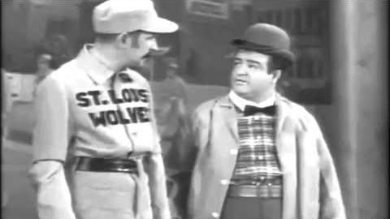
Who’s on First?

Slide 9
Take home message
Improvements don’t come overnight! Remember to encourage your student by highlighting areas of strength in their work!
Check in with students to see if particular techniques are more/less helpful for them, everyone is different and will have different preferences.
Take time to connect with the student and find common ground, it’s worth it to spend a few minutes getting them comfortable.
Be mindful that you don’t know everyone’s background, and always give students the benefit of the doubt.
You got this!

