Slide 1
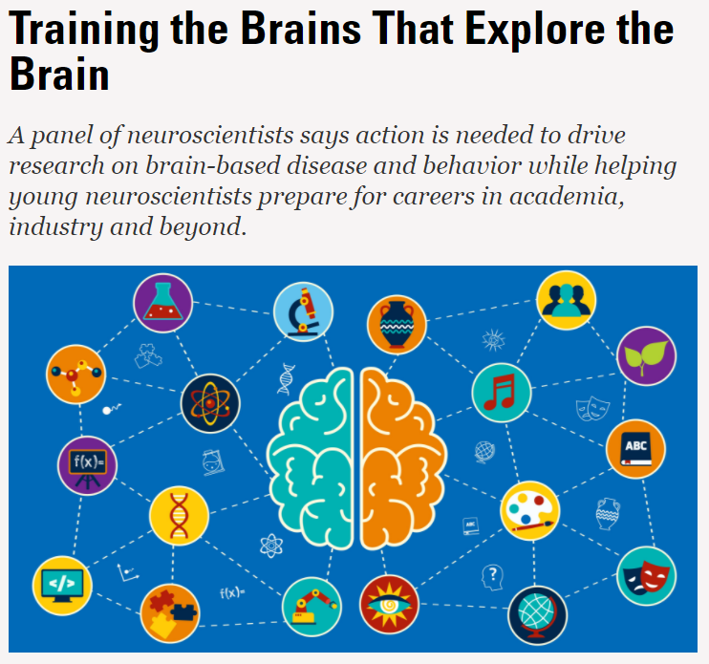

Molecules
Cells
Anatomy
Circuits
Systems
Organisms
Behavior

Slide 2
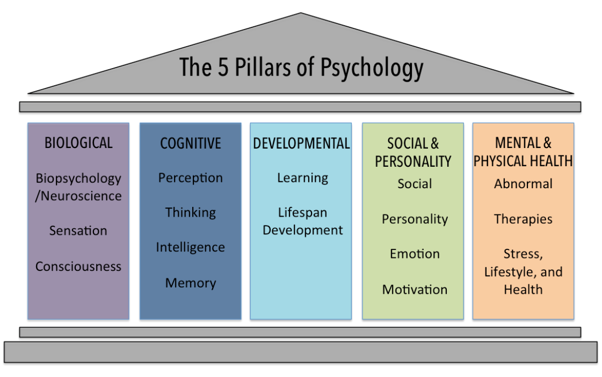

Slide 3
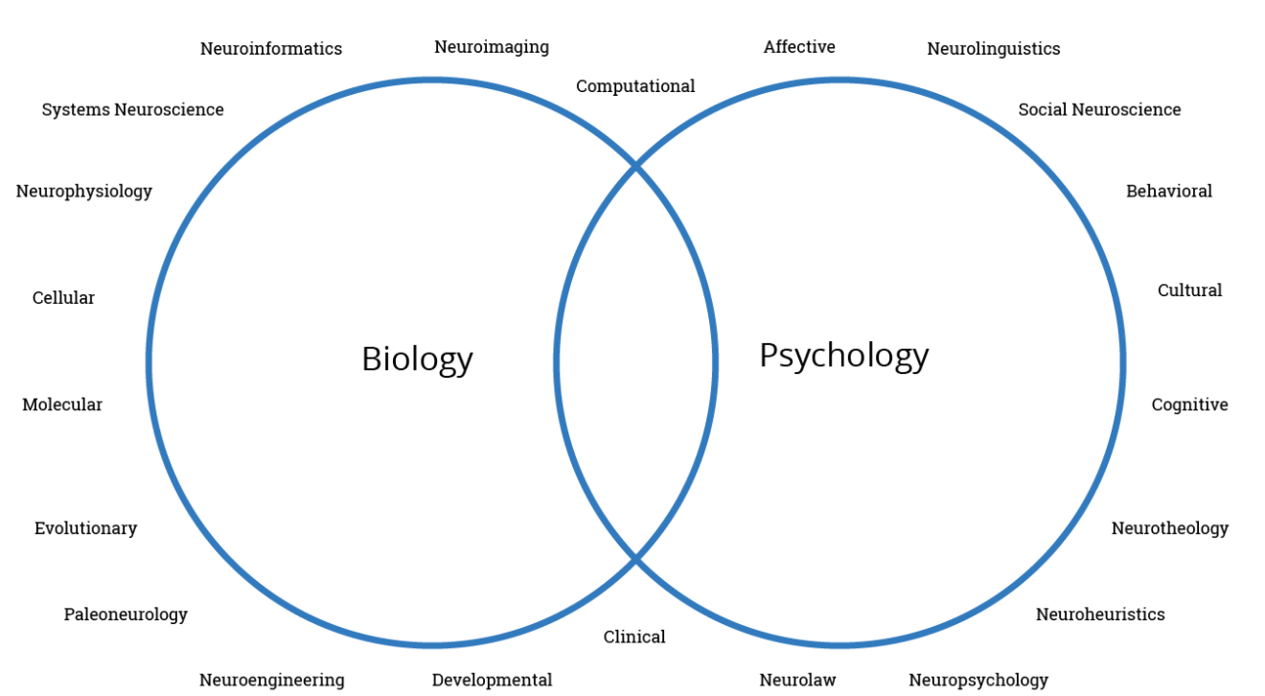

Slide 4
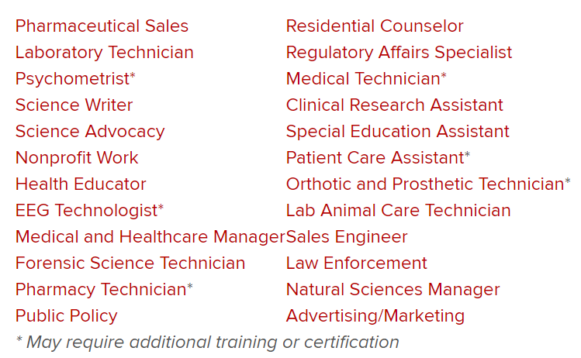
https://neurosciencemajor.osu.edu/careers-neuroscience

Slide 5
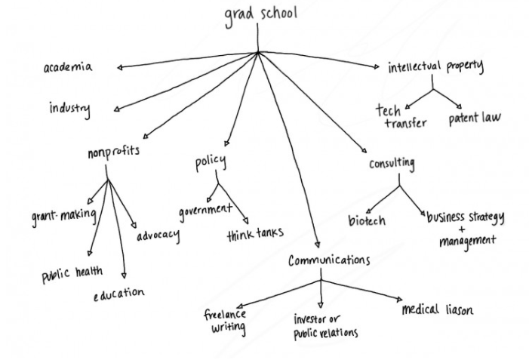
https://www.washington.edu/trends/helping-graduate-students-find-alternative-careers/ Image courtesy of Liza Shoenfeld

