Slide 1

The Impact of Competition on Cooperation: Evidence from a Series of Bargaining Game Experiments
Cole Wright
Professor Schneider

Slide 2
Overview
Game theory is founded on the belief that players in social dilemmas are rational agents—meaning that they will behave in such a way as to maximize individual benefit at the expense of others.
However, both laboratory experiments and everyday behavior consistently demonstrate that humans possess a capacity to cooperate and will do so even at a cost to themselves.

Slide 3
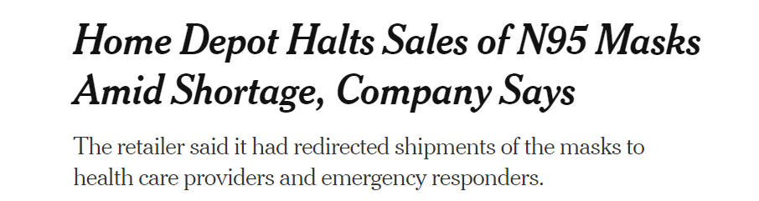
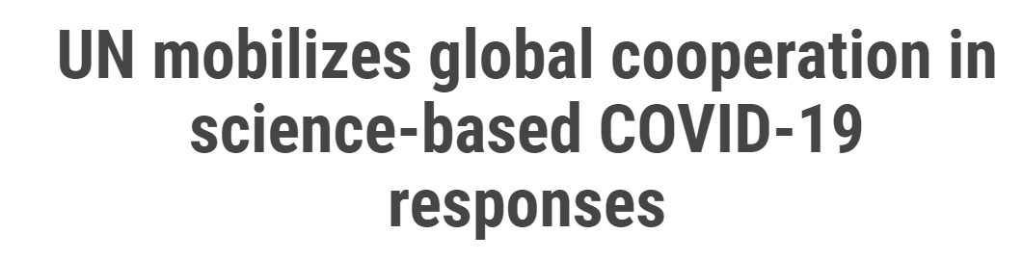


Cooperation in action
This evidence of cooperation challenges the theoretical foundation of game theory and have catalyzed a desire to understand the motivations of cooperative behavior that help to explain the deviation from theoretical predictions.
https://www.nytimes.com/2020/04/01/business/n95-face-masks-home-depot-virus.html
https://www.un.org/en/un-coronavirus-communications-team/un-mobilizes-global-cooperation-science-based-covid-19-responses

Slide 4
Literature review
Why theories of rationality are flawed and insufficient:
  Simon (1982)
  Dawes and Thaler (1988)
  Tooby, Cosmides, and Price (2006)
Examples of cooperation in the experimental setting:
  Marwell & Ames (1981)
  Capra, Goeree, Gomez, and Holt (1999)
  Deck (2001; 2009)

Slide 5
Prisoner’s Dilemma
 | Cooperate | Defect
Cooperate | 7 ; 7 | 0 ; 10
Defect | 10 ; 0 | 3 ; 3
The Prisoner’s Dilemma offers a choice between Cooperation and Defection
  {Cooperate ; Cooperate} results in highest collective payoff
  However, defection offers the highest individual payoff, at a risk
 | $0.80 | $1.50 | … | $2.00
$0.80 | $0.80 ; $0.80 | $1.00 ; $0.60 | … | $1.00 ; $0.60
$1.50 | $0.60 ; $1.00 | $1.50 ; $1.50 | … | $1.70 ; $1.30
… | … | … | … | …
$2.00 | $0.60 ; $1.00 | $1.30 ; $1.70 | … | $2.00 ; $2.00
The Traveler’s Dilemma offers a greater strategy set interval for players to choose from
  Deviation from the cooperative outcome can occur more gradually

Slide 6
Parameters of Traveler’s Dilemma
Each player is anonymously matched with another player for one treatment lasting six rounds unless otherwise specified
In each round, players simultaneously claim a dollar amount from $0.80 to $2.00
  The player who claims the lower amount will receive that amount, plus a reward of $0.20
  The player who claims the higher amount will receive the lower claim, minus a penalty of $0.20
  If players claim the same amount, they receive that amount with no reward or penalty

Slide 7
Predictions of the Traveler’s Dilemma
Nash Equilibrium: $0.80
  “Rational” players will continually attempt to undercut their opponent by claiming a lower amount to avoid penalty and earn reward, thus pushing the game to a Nash Equilibrium of $0.80
Cooperative Claim: $2.00
  Cooperation in the Traveler’s Dilemma can be sustained if both partners consistently claim $2.00 over the course of the game, as neither player is penalized or rewarded
  However, this is an inherently risky strategy, as rational players in this interaction will claim $1.99 in order to obtain the highest possible payoff of $2.19

Slide 8
Traveler’s Dilemma
Player 2’s Claim
 | $0.80 | $1.20 | $1.50 | … | $1.99 | $2.00
$0.80 | $0.80 ; $0.80 | $1.00 ; $0.60 | $1.00 ; $0.60 | … | $1.00 ; $0.60 | $1.00 ; $0.60
$1.20 | $0.60 ; $1.00 | $1.20 ; $1.20 | $1.40 ; $1.00 | … | $1.40 ; $1.00 | $1.40 ; $1.00
$1.50 | $0.60 ; $1.00 | $1.00 ; $1.40 | $1.50 ; $1.50 | … | $1.70 ; $1.30 | $1.70 ; $1.30
… | … | … | … | … | … | …
$1.99 | $0.60 ; $1.00 | $1.00 ; $1.40 | $1.30 ; $1.70 | … | $1.99 ; $1.99 | $2.19 ; $1.79
$2.00 | $0.60 ; $1.00 | $1.00 ; $1.40 | $1.30 ; $1.70 | … | $1.79 ; $2.19 | $2.00 ; $2.00
Player 1’s Claim

Slide 9
Experiment Overview
Participants were members of College Course 210: Theory of Games and Experimental Game Theory during the Fall 2019 semester
All experiments were conducted in the library computer lab during the class’s 75-minute meeting time once per week
Participants were student from a variety of majors
At the start of each game participants were given the rules and parameters of the game, including:
  Length of the game
  Number of partners they would have, and when partners would change
  Unique features of the game (e.g. elimination rounds)

Slide 10

Incentives
Optional laboratory fee of $50
  Players who paid the laboratory fee and won a game during the semester would receive a portion of the “prize fund” (sum of lab fees paid) equal to:
        $\frac{Total Dollars in Prize Fund}{Total Number of Games Played}$
Grading structure and grade boosters
  50% of participants’ final grade was determined based on performance in games throughout the semester
  Students were also rewarded with a grade increase based on games won and consistent placement in the top 20% of participants

Slide 11
Research Questions
How does the intensity of competition impact cooperation?
How does the duration of the game impact cooperation?
How does group size impact cooperation?

Slide 12
Methodology: Intensity of Competition
24 initial players
Players with lowest earnings eliminated after every three six-round treatments
Game 1: Groups of two; bottom four players eliminated
24 → 20 → 16 → 12
Game 2: Groups of three; bottom six players eliminated
24 → 18 → 12
Game 3: Groups of four; bottom four players eliminated
24 → 20 → 16

Slide 13
Methodology: Game Duration
Each game began with 28 players and was played for six treatments
  Four players with lowest earnings eliminated after first six treatments: 28 → 24
  Game was then played for six more treatments
Game 1: Treatments lasted for six rounds each
Game 2: Treatments lasted for ten rounds each

Slide 14
Methodology: Group Size
24 players
  Games were played for six ten-round treatments
Game 1: Groups of two
Game 2: Groups of three
Game 3: Groups of four

Slide 15
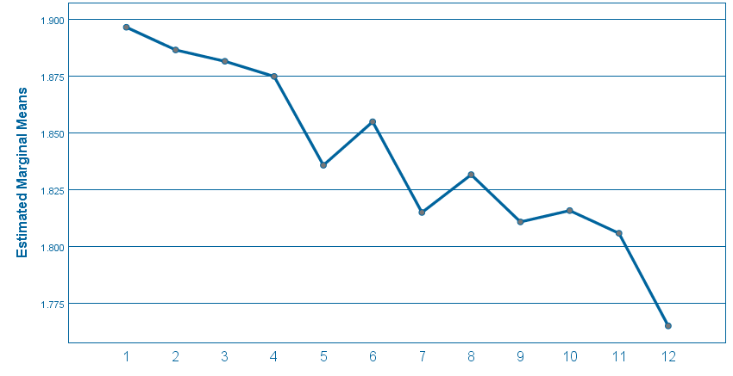
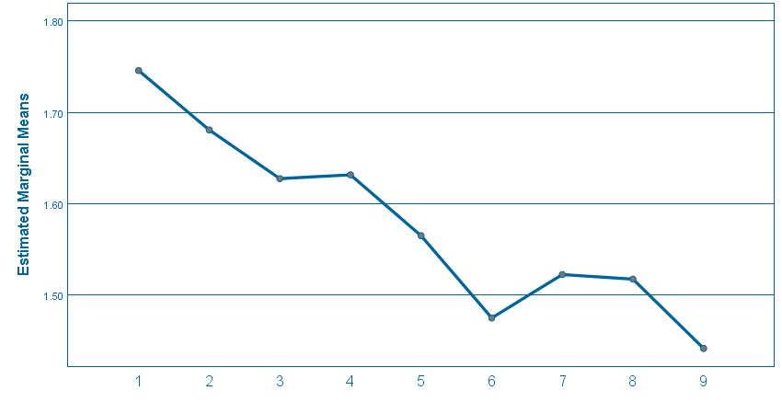
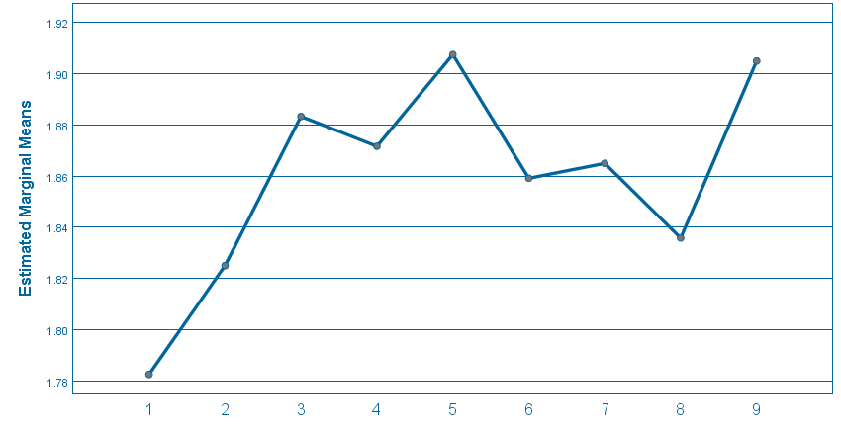
Re
Results: Intensity of competition
Game 1
Game 2
Game 3
Results from Games 1 and 2 showed a clear negative correlation between Earnings/Claims and Intensity of Competition.
However, results from Game 3 were inconsistent with those of Game 1 and 2.
Conclusion: Intensity of Competition does not have a significant impact on cooperation.
However, the inconsistency of our results suggest that similar experiments would be beneficial to address the weaknesses of our experiment (specifically sample size)

Slide 16
Results: Game Duration
 | Earnings | Claims
24 players | P = 0.015 | P = 0.249
28 Players | P < 0.001 | P < 0.001
Relationship between Earnings/Claims and Game Duration was found to be statistically significant in three of four cases.
Conclusion: Game Duration has a significant impact on cooperation. However, further tests should be conducted to determine the extent of this relationship, as our results did not show statistical significance in every case as we expected.

Slide 17
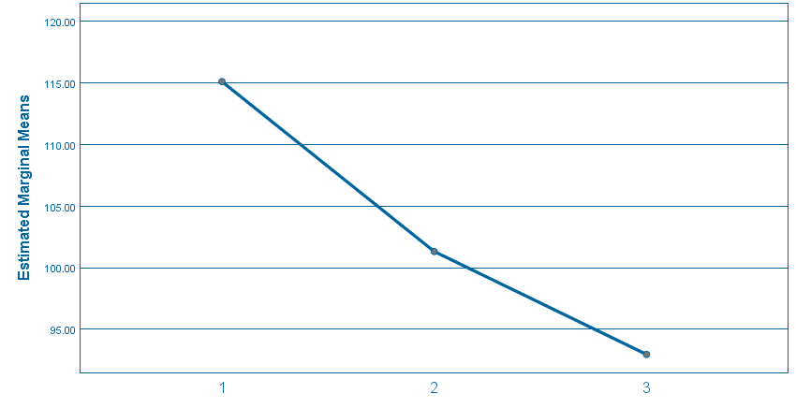
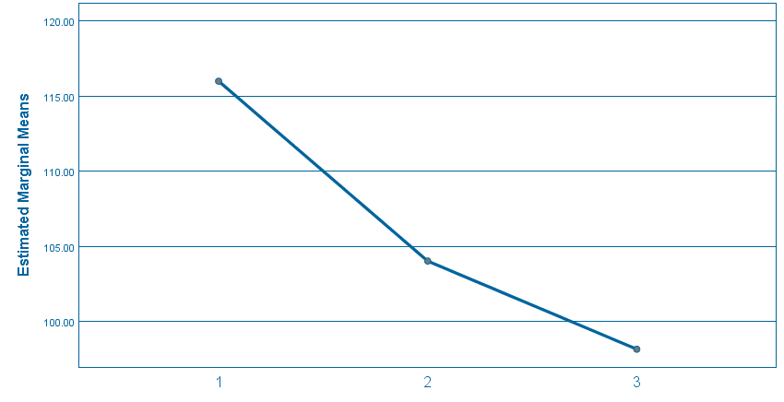
Results: Group Size
Earnings
Claims
The decline in both Earnings and Claims as groups increased in size was statistically significant. This was consistent with both our hypothesis and the predictions of the Tragedy of the Commons theory of shared resources.
Conclusion: Group size has a significant impact on cooperation in social dilemmas.

Slide 18
Expected Findings
Game duration and cooperation showed positive correlation in all cases
    Longer game = greater opportunity for players to establish a reputation that they were willing to cooperate
    Participants identified that early deviation from the cooperative claim would have more extensive consequences in longer games
Average Earnings: 28 Players
Average Claims: 28 Players
 | Mean
Game 1 | 1.703
Game 2 | 1.928
 | Mean
Game 1 | 1.919
Game 2 | 1.942
Average Earnings: 24 Players
Average Claims: 24 Players
 | Mean
Game 1 | 1.885
Game 2 | 1.917
 | Mean
Game 1 | 1.770
Game 2 | 1.931

Slide 19
Expected findings
The Tragedy of the Commons theory was supported by all Group Size test results
Deviation from the cooperative outcome $2.00 occurred earlier, and average earnings and claims converged on the Nash Equilibrium $0.80 much more quickly
    More group members = greater pressure to be the first person to defect to avoid penalty
    Players identified that a strategy of successfully claiming the lowest amount in each round would make them no worse off than the other members of their group

Slide 20
Unexpected Findings
Results for Intensity of Competition were inconsistent across our three experiments
Earnings and Claims declined in Games 1 and 2 but increased in Game 3
  Possible explanations:
    Small sample size
    With fewer total groups in Game 3, an individual group’s decisions may have had a greater impact on results
Results for Game Duration (24 players) were statistically significant for Earnings (p = 0.015) but not for Claims (p = 0.249)

Slide 21
Questions for Future Research
Would increasing the number of participants result in a statistically significant relationship between Intensity of Competition and cooperation?
  Larger sample size would address a possible weakness of our study by decreasing the weight of individual groups’ impact on results
How can the impact of duration of social interaction and group size on cooperation be used to generate greater cooperation in competitive environments?
What sort of policy prescriptions would be effective in addressing the Tragedy of the Commons theory that explains modern dilemmas such as overfishing and climate change?

Slide 22
THANK YOU

